Slide 1
MPOPF Simulation and OpenDSS Validation
Aryan Ritwajeet Jha
Graduate Research Assistant
Washington State University
Notes:
Remember to hit the reset button to make sure all the page elements react properly.
There are 20 different layouts that you can choose from.

Slide 2
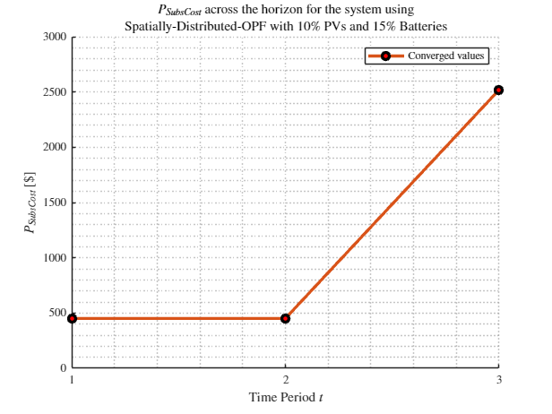
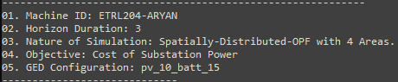
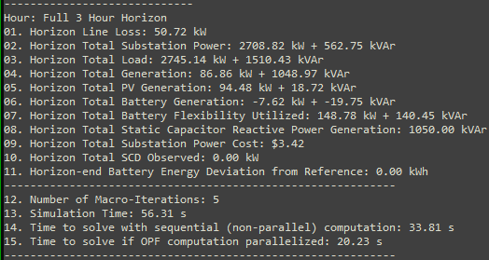
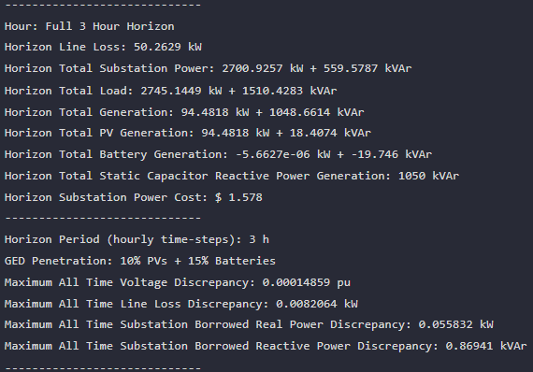

MPDOPF Verified for $T=3, PV=10\%, Batt=15\%$
strLoadShapeCost = 'New Loadshape.LoadShapeCost npts =3 interval = 1 mult = [0.048204 0.048204 0.30181]'
OpenDSS Def Profiles
Gen Cost
MPDOPF Simulation Results
OpenDSS Powerflow Results
Timings
Discrepancies

Slide 3
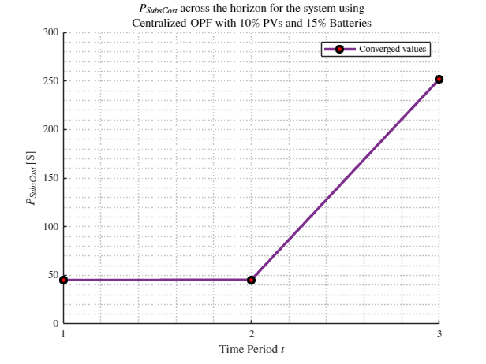
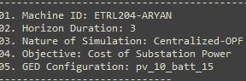
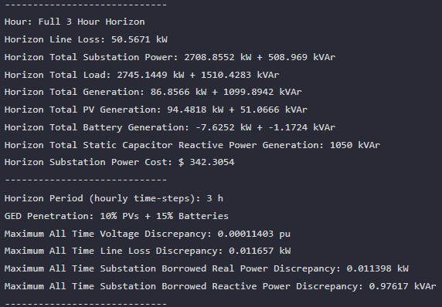
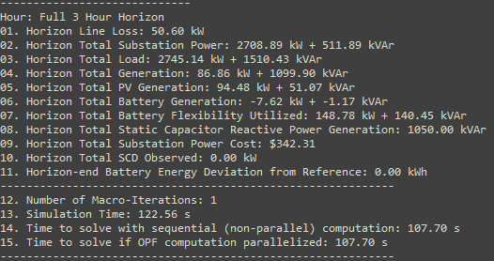

MPCOPF Verified for $T=3, PV=10\%, Batt=15\%$
strLoadShapeCost = 'New Loadshape.LoadShapeCost npts =3 interval = 1 mult = [0.048204 0.048204 0.30181]'
OpenDSS Def Profiles
Gen Cost
MPDOPF Simulation Results
OpenDSS Powerflow Results
Timings
Discrepancies

Slide 4
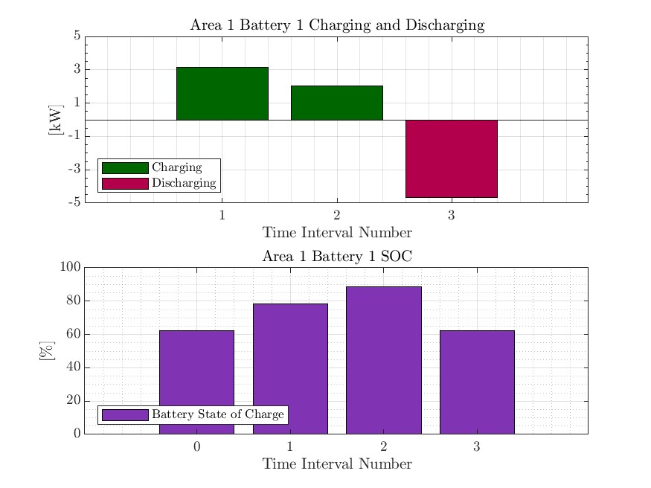
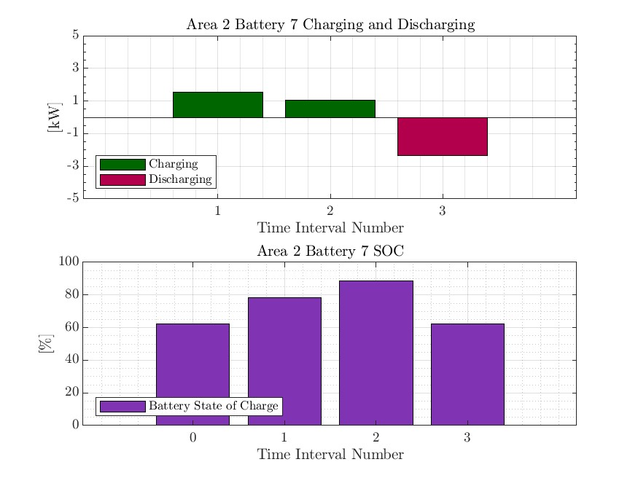
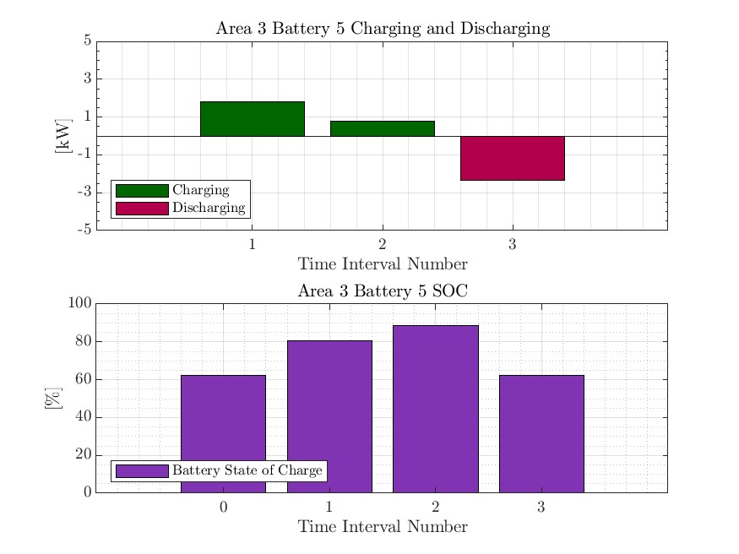
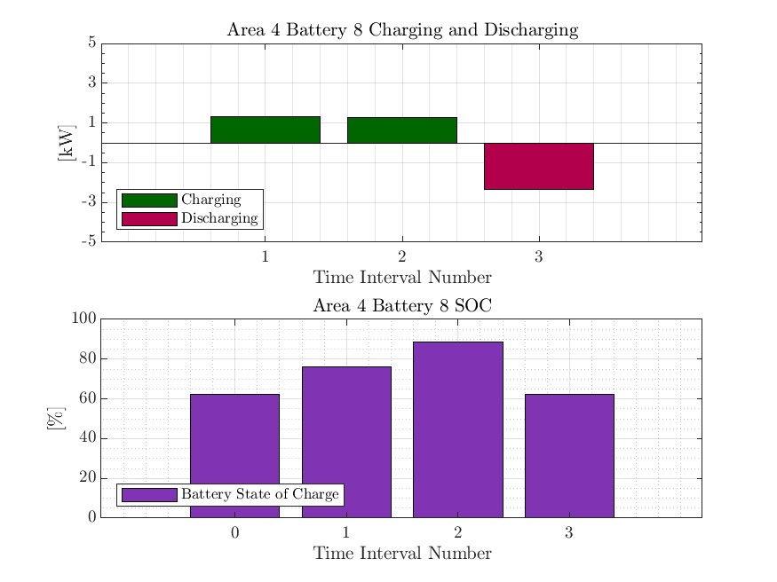

MPDOPF Verified for $T=3, PV=10\%, Batt=15\%$
strLoadShapeCost = 'New Loadshape.LoadShapeCost npts =3 interval = 1 mult = [0.048204 0.048204 0.30181]'
OpenDSS Def Profiles
Gen Cost

Slide 5
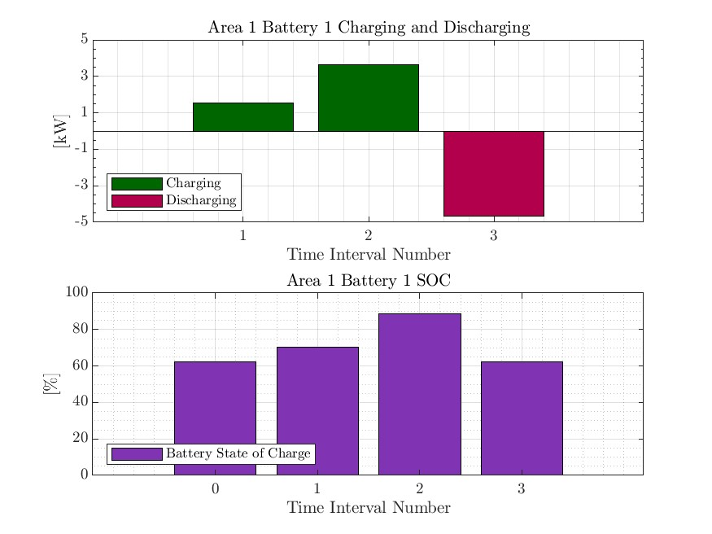

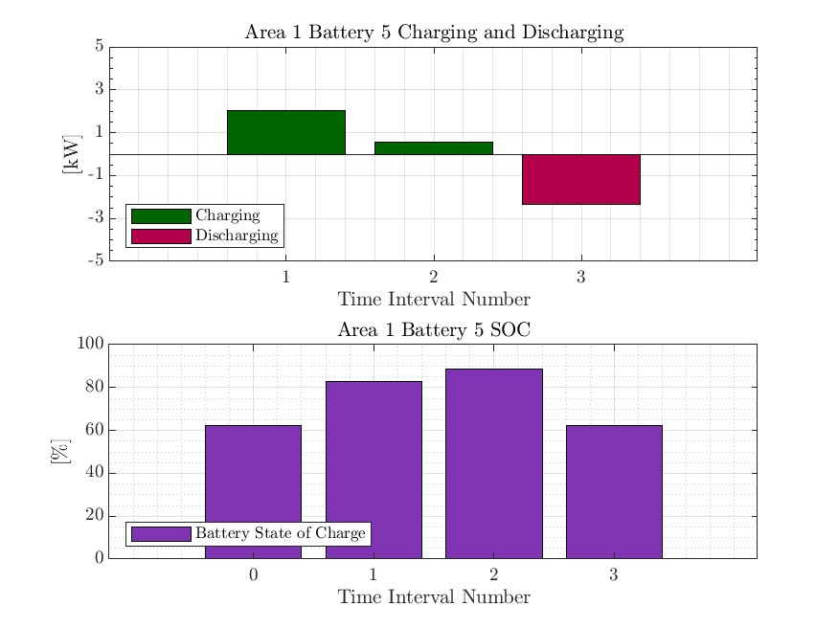


MPCOPF Verified for $T=3, PV=10\%, Batt=15\%$
strLoadShapeCost = 'New Loadshape.LoadShapeCost npts =3 interval = 1 mult = [0.048204 0.048204 0.30181]'
OpenDSS Def Profiles
Gen Cost

Slide 6
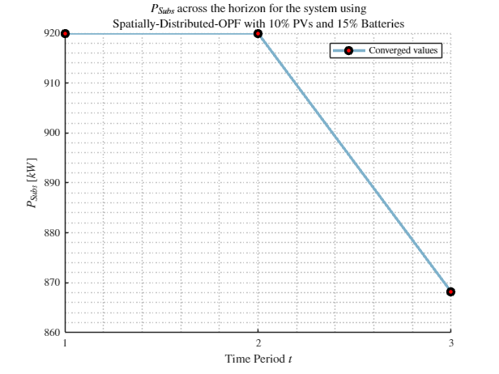
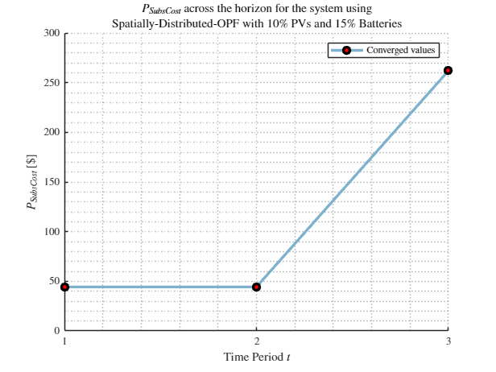
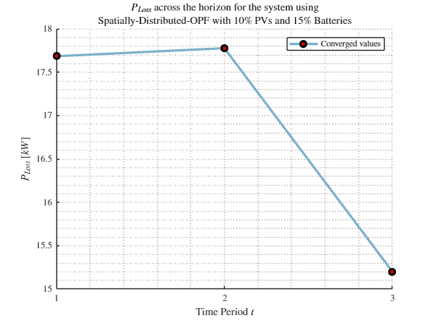
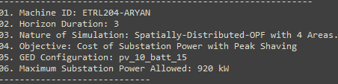
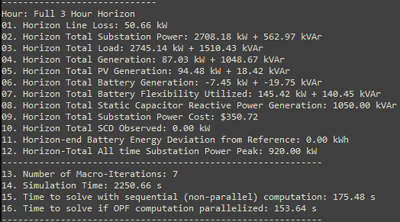
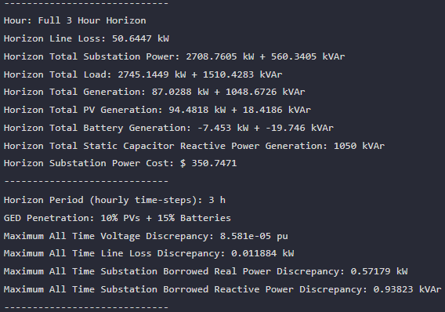



MPDOPF Verified for $T=3, PV=10\%, Batt=15\%$
strLoadShapeCost = 'New Loadshape.LoadShapeCost npts =3 interval = 1 mult = [0.048204 0.048204 0.30181]'
$P_{Subs}^{t}$
$P_{SubsCost}^{t}$
OpenDSS Def Profiles
Gen Cost + Peak Shave
OpenDSS Powerflow Results
$$P_{Loss}^{t}$$
MPDOPF Simulation Results
Timings
Discrepancies

Slide 7
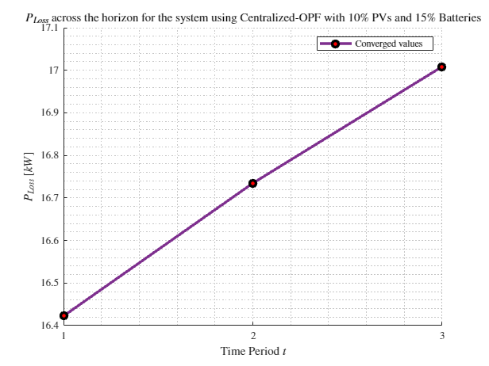
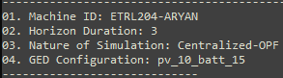
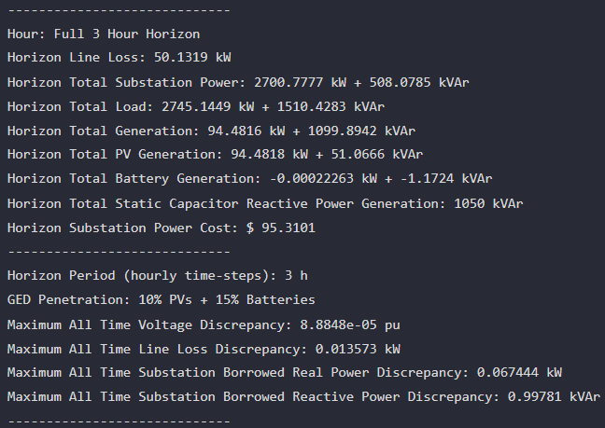
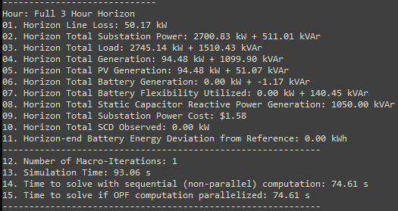
MPCOPF Verified for $T=3, PV=10\%, Batt=15\%$
strLoadShapeCost = 'New Loadshape.LoadShapeCost npts =3 interval = 1 mult = [0.048204 0.048204 0.30181]'
OpenDSS Def Profiles
Gen Cost + Peak Shave
MPDOPF Simulation Results
OpenDSS Powerflow Results
Timings
Discrepancies

Slide 8
MPDOPF Verified for $T=3, PV=10\%, Batt=15\%$
strLoadShapeCost = 'New Loadshape.LoadShapeCost npts =3 interval = 1 mult = [0.048204 0.048204 0.30181]'
OpenDSS Def Profiles
Gen Cost + Peak Shave

Slide 9
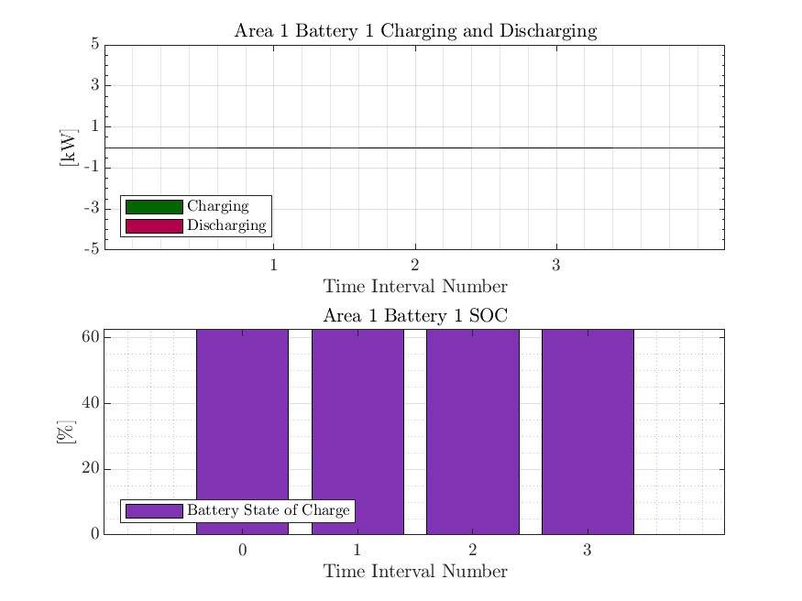



MPCOPF Verified for $T=3, PV=10\%, Batt=15\%$
strLoadShapeCost = 'New Loadshape.LoadShapeCost npts =3 interval = 1 mult = [0.048204 0.048204 0.30181]'
OpenDSS Def Profiles
Gen Cost + Peak Shave

Slide 10
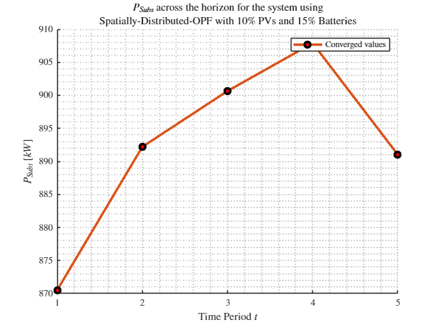
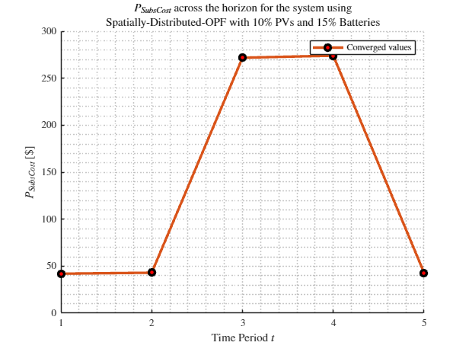
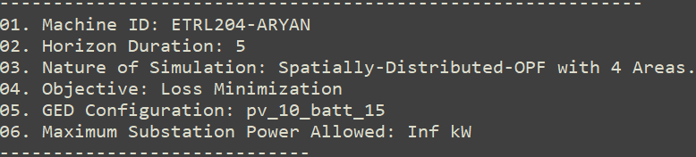
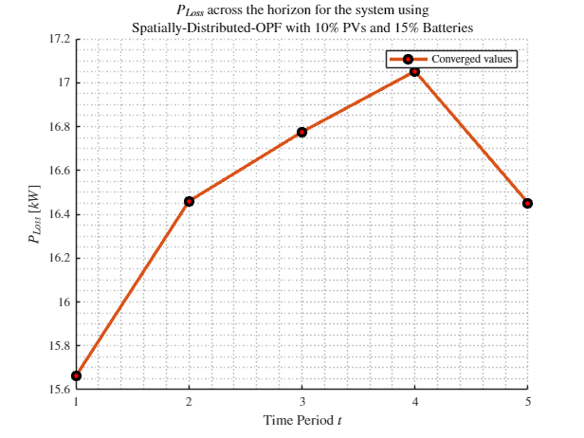
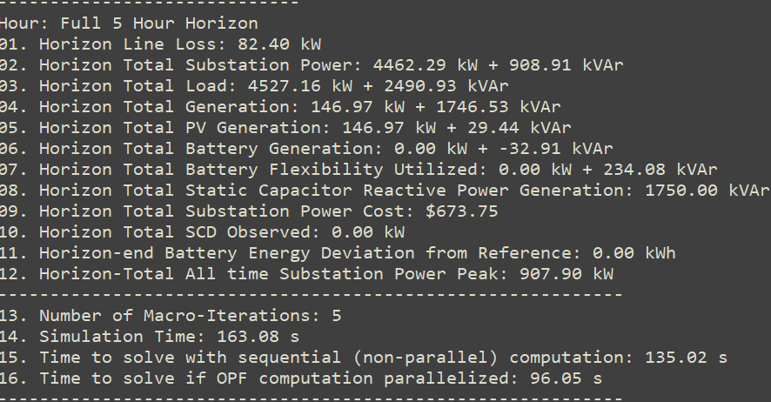
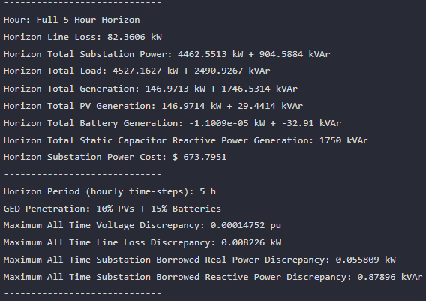
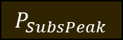

MPDOPF Verified for $T=5, PV=10\%, Batt=15\%$
strLoadShapeCost = 'New Loadshape.LoadShapeCost npts =5 interval = 1 mult = [0.048204 0.048204 0.30181 0.30181 0.048204]'
$P_{Subs}^{t}$
$P_{SubsCost}^{t}$
OpenDSS Def Profiles
Line Losses
OpenDSS Powerflow Results
$$P_{Loss}^{t}$$
MPDOPF Simulation Results
Objective
$$P_{SubsPeak}$$
Timings
Discrepancies

Slide 11
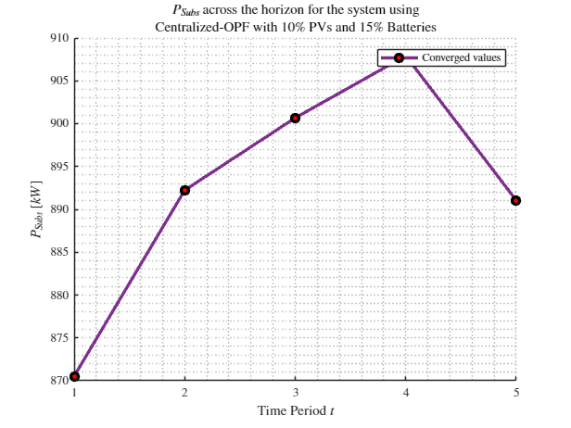
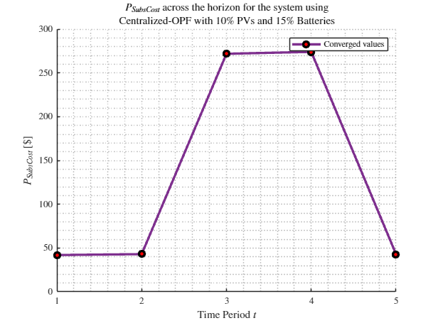
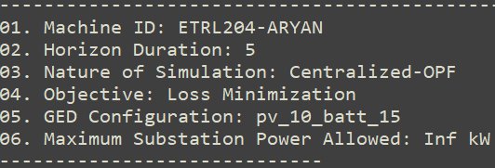
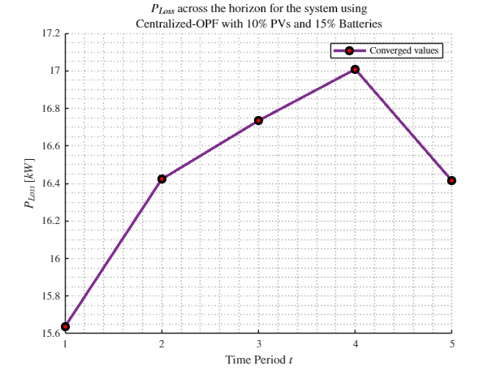
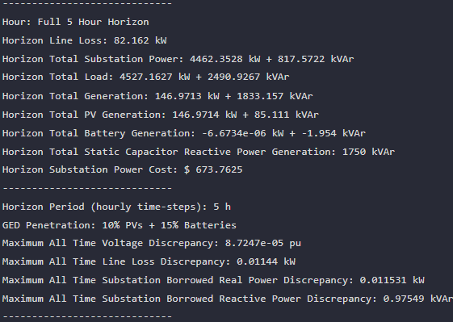
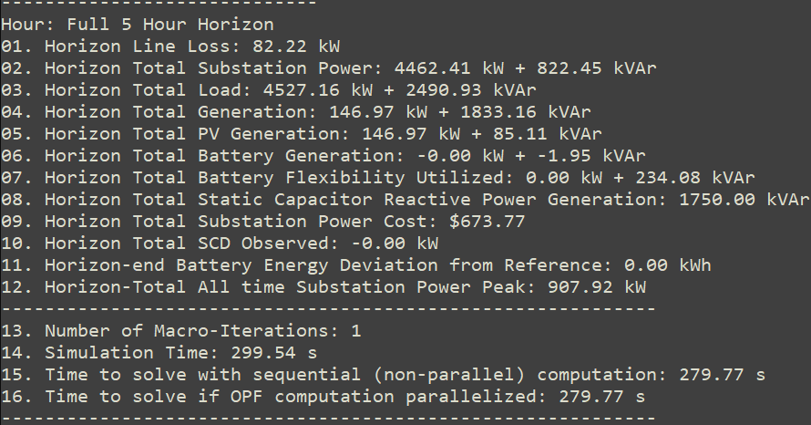

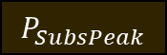
MPCOPF Verified for $T=5, PV=10\%, Batt=15\%$
strLoadShapeCost = 'New Loadshape.LoadShapeCost npts =5 interval = 1 mult = [0.048204 0.048204 0.30181 0.30181 0.048204]'
$P_{Subs}^{t}$
$P_{SubsCost}^{t}$
OpenDSS Def Profiles
Line Losses
OpenDSS Powerflow Results
$$P_{Loss}^{t}$$
MPDOPF Simulation Results
Objective
$$P_{SubsPeak}$$
Discrepancies
Timings

Slide 12
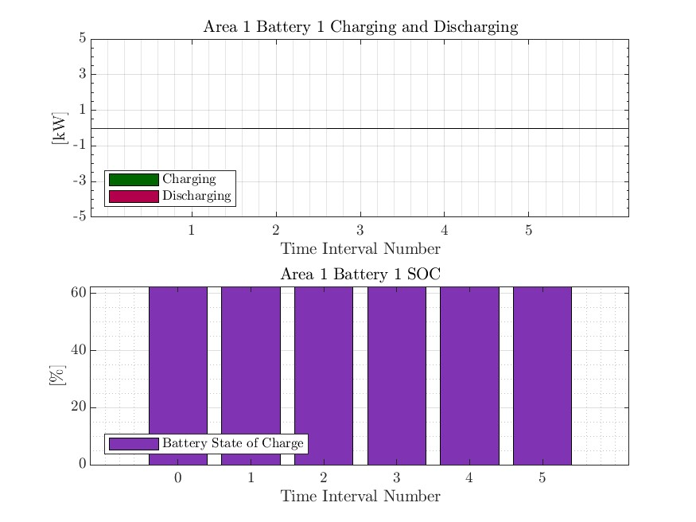
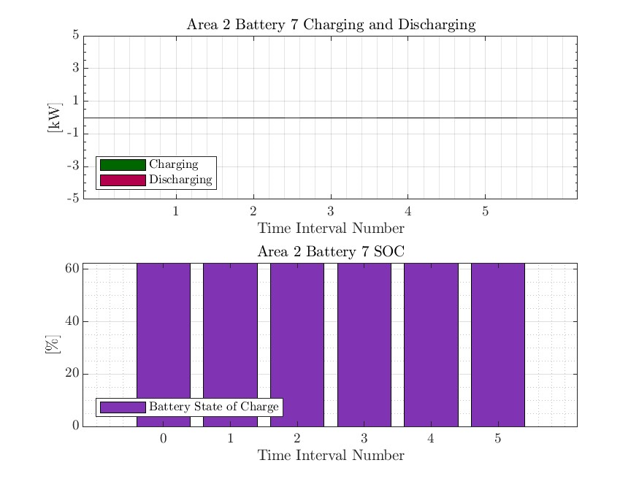



MPDOPF Verified for $T=5, PV=10\%, Batt=15\%$
strLoadShapeCost = 'New Loadshape.LoadShapeCost npts =5 interval = 1 mult = [0.048204 0.048204 0.30181 0.30181 0.048204]'
OpenDSS Def Profiles
Line Losses

Slide 13




MPCOPF Verified for $T=5, PV=10\%, Batt=15\%$
strLoadShapeCost = 'New Loadshape.LoadShapeCost npts =5 interval = 1 mult = [0.048204 0.048204 0.30181 0.30181 0.048204]'
OpenDSS Def Profiles
Line Losses

Slide 14
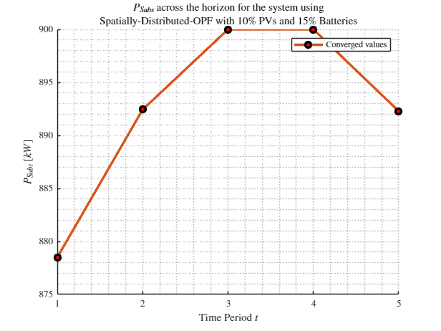

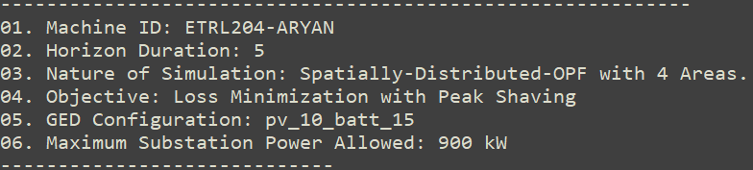
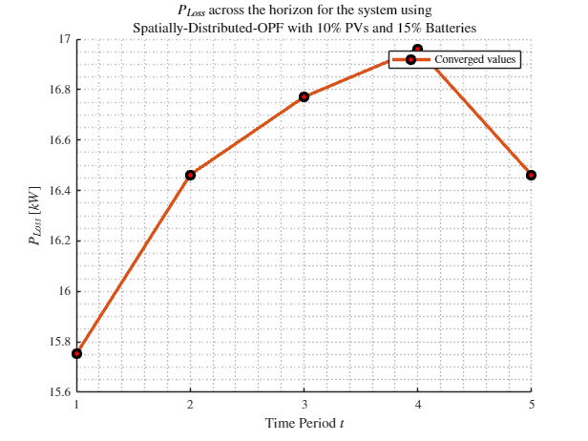

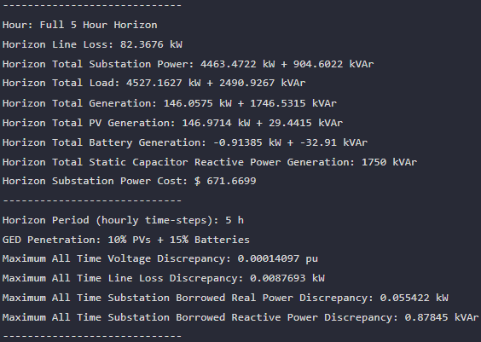
MPDOPF Verified for $T=5, PV=10\%, Batt=15\%$
strLoadShapeCost = 'New Loadshape.LoadShapeCost npts =5 interval = 1 mult = [0.048204 0.048204 0.30181 0.30181 0.048204]'
$P_{Subs}^{t}$
$P_{SubsCost}^{t}$
OpenDSS Def Profiles
Line Losses + Peak Shave
OpenDSS Powerflow Results
$$P_{Loss}^{t}$$
MPDOPF Simulation Results
Objective
$$P_{SubsPeak}$$
Timings
Discrepancies

Slide 15
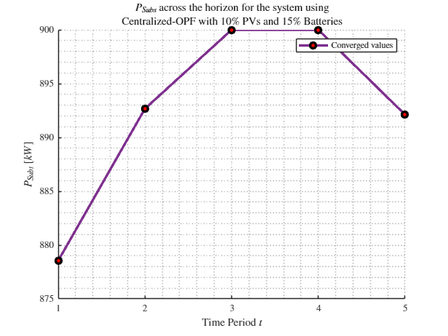

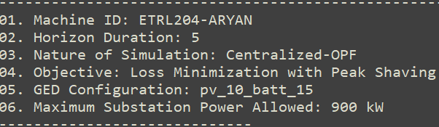
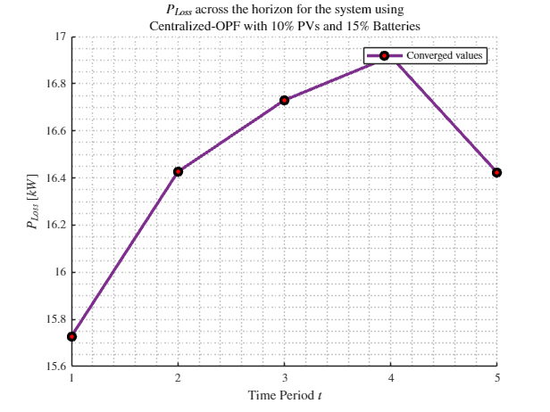
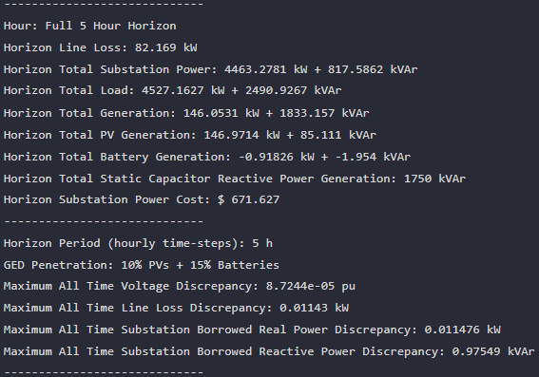


MPCOPF Verified for $T=5, PV=10\%, Batt=15\%$
strLoadShapeCost = 'New Loadshape.LoadShapeCost npts =5 interval = 1 mult = [0.048204 0.048204 0.30181 0.30181 0.048204]'
$P_{Subs}^{t}$
$P_{SubsCost}^{t}$
OpenDSS Def Profiles
Line Losses + Peak Shave
OpenDSS Powerflow Results
$$P_{Loss}^{t}$$
MPDOPF Simulation Results
Objective
$$P_{SubsPeak}$$
Timings
Discrepancies

Slide 16
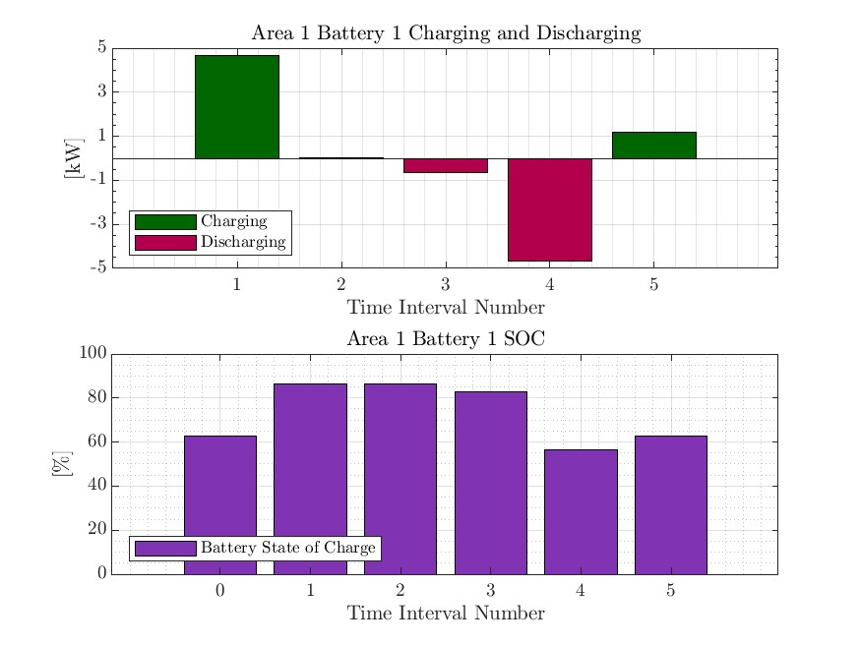
MPDOPF Verified for $T=5, PV=10\%, Batt=15\%$
strLoadShapeCost = 'New Loadshape.LoadShapeCost npts =5 interval = 1 mult = [0.048204 0.048204 0.30181 0.30181 0.048204]'
OpenDSS Def Profiles
Line Losses + Peak Shave

Slide 17


MPCOPF Verified for $T=5, PV=10\%, Batt=15\%$
strLoadShapeCost = 'New Loadshape.LoadShapeCost npts =5 interval = 1 mult = [0.048204 0.048204 0.30181 0.30181 0.048204]'
OpenDSS Def Profiles
Line Losses + Peak Shave

Slide 18






MPDOPF Verified for $T=5, PV=10\%, Batt=15\%$
strLoadShapeCost = 'New Loadshape.LoadShapeCost npts =5 interval = 1 mult = [0.048204 0.048204 0.30181 0.30181 0.048204]'
$P_{Subs}^{t}$
$P_{SubsCost}^{t}$
OpenDSS Def Profiles
Gen Cost
OpenDSS Powerflow Results
$$P_{Loss}^{t}$$
MPDOPF Simulation Results
Objective
$$P_{SubsPeak}$$
Timings
Discrepancies

Slide 19






MPCOPF Verified for $T=5, PV=10\%, Batt=15\%$
strLoadShapeCost = 'New Loadshape.LoadShapeCost npts =5 interval = 1 mult = [0.048204 0.048204 0.30181 0.30181 0.048204]'
$P_{Subs}^{t}$
$P_{SubsCost}^{t}$
OpenDSS Def Profiles
Gen Cost
OpenDSS Powerflow Results
$$P_{Loss}^{t}$$
MPDOPF Simulation Results
Objective
$$P_{SubsPeak}$$
Timings
Discrepancies

Slide 20




MPDOPF Verified for $T=5, PV=10\%, Batt=15\%$
strLoadShapeCost = 'New Loadshape.LoadShapeCost npts =5 interval = 1 mult = [0.048204 0.048204 0.30181 0.30181 0.048204]'
OpenDSS Def Profiles
Gen Cost

Slide 21




MPCOPF Verified for $T=5, PV=10\%, Batt=15\%$
strLoadShapeCost = 'New Loadshape.LoadShapeCost npts =5 interval = 1 mult = [0.048204 0.048204 0.30181 0.30181 0.048204]'
OpenDSS Def Profiles
Gen Cost

Slide 22






MPDOPF Verified for $T=5, PV=10\%, Batt=15\%$
strLoadShapeCost = 'New Loadshape.LoadShapeCost npts =5 interval = 1 mult = [0.048204 0.048204 0.30181 0.30181 0.048204]'
$P_{Subs}^{t}$
$P_{SubsCost}^{t}$
OpenDSS Def Profiles
Gen Cost + Peak Shave
OpenDSS Powerflow Results
$$P_{Loss}^{t}$$
MPDOPF Simulation Results
Timings
Discrepancies

Slide 23






MPCOPF Verified for $T=5, PV=10\%, Batt=15\%$
strLoadShapeCost = 'New Loadshape.LoadShapeCost npts =5 interval = 1 mult = [0.048204 0.048204 0.30181 0.30181 0.048204]'
$P_{Subs}^{t}$
$P_{SubsCost}^{t}$
OpenDSS Def Profiles
Gen Cost + Peak Shave
OpenDSS Powerflow Results
$$P_{Loss}^{t}$$
MPDOPF Simulation Results
Discrepancies
Timings

Slide 24




MPDOPF Verified for $T=5, PV=10\%, Batt=15\%$
strLoadShapeCost = 'New Loadshape.LoadShapeCost npts =5 interval = 1 mult = [0.048204 0.048204 0.30181 0.30181 0.048204]'
OpenDSS Def Profiles
Gen Cost + Peak Shave

Slide 25




MPCOPF Verified for $T=5, PV=10\%, Batt=15\%$
strLoadShapeCost = 'New Loadshape.LoadShapeCost npts =5 interval = 1 mult = [0.048204 0.048204 0.30181 0.30181 0.048204]'
OpenDSS Def Profiles
Gen Cost + Peak Shave

Slide 26







MPDOPF Verified for $T=12, PV=10\%, Batt=15\%$
$P_{Subs}^{t}$
$P_{SubsCost}^{t}$
OpenDSS Def Profiles
Gen Cost + Peak Shave
OpenDSS Powerflow Results
$$P_{Loss}^{t}$$
MPDOPF Simulation Results
Objective
$$P_{SubsPeak}$$
Timings
Discrepancies

Slide 27

MPCOPF Verified for $T=12, PV=10\%, Batt=15\%$
$P_{Subs}^{t}$
$P_{SubsCost}^{t}$
OpenDSS Def Profiles
Gen Cost + Peak Shave
OpenDSS Powerflow Results
$$P_{Loss}^{t}$$
MPDOPF Simulation Results
Timings
Discrepancies

Slide 28





MPDOPF Verified for $T=12, PV=10\%, Batt=15\%$
OpenDSS Def Profiles
Gen Cost + Peak Shave

Slide 29

MPCOPF Verified for $T=12, PV=10\%, Batt=15\%$
OpenDSS Def Profiles
Gen Cost + Peak Shave

Slide 30
MPDOPF Verified for $T=3, PV=10\%, Batt=15\%$
strLoadShape = 'New Loadshape.LoadShape npts =3 interval = 1 mult = [0.777 0.787 0.796]'
strLoadShapePV = 'New Loadshape.LoadShapePV npts =3 interval = 1 mult = [0.8 0.9 1]'
$P_{Subs}^{t}$
$P_{SubsCost}^{t}$
OpenDSS Def Profiles
Gen Cost + Peak Shave
OpenDSS Powerflow Results
$$P_{Loss}^{t}$$
MPDOPF Simulation Results
Timings
Discrepancies

Slide 31
MPCOPF Verified for $T=3, PV=10\%, Batt=15\%$
$P_{Subs}^{t}$
$P_{SubsCost}^{t}$
OpenDSS Def Profiles
Gen Cost + Peak Shave
OpenDSS Powerflow Results
$$P_{Loss}^{t}$$
MPDOPF Simulation Results
Timings
Discrepancies

Slide 32
MPDOPF Verified for $T=3, PV=10\%, Batt=15\%$
OpenDSS Def Profiles
Gen Cost + Peak Shave

Slide 33
MPCOPF Verified for $T=3, PV=10\%, Batt=15\%$
OpenDSS Def Profiles
Gen Cost + Peak Shave

Slide 34

Latest Slides End Here.
Previous Slides Follow

Slide 35





MPDOPF Verified for $T=2, PV=10\%, Batt=15\%$
strLoadShape = 'New Loadshape.LoadShape npts =2 interval = 1 mult = [1 0.7]'
strLoadShapePV = 'New Loadshape.LoadShapePV npts =2 interval = 1 mult = [1.4 0.8]'
MPDOPF Simulation Results
Alternative Profiles
OpenDSS Powerflow Results

Slide 36





MPCOPF Verified for $T=2, PV=10\%, Batt=15\%$
strLoadShape = 'New Loadshape.LoadShape npts =2 interval = 1 mult = [1 0.7]'
strLoadShapePV = 'New Loadshape.LoadShapePV npts =2 interval = 1 mult = [1.4 0.8]'
MPCOPF Simulation Results
Alternative Profiles
OpenDSS Powerflow Results

Slide 37





MPDOPF Verified for $T=2, PV=10\%, Batt=15\%$
strLoadShape = 'New Loadshape.LoadShape npts =2 interval = 1 mult = [1 0.7]'
strLoadShapePV = 'New Loadshape.LoadShapePV npts =2 interval = 1 mult = [1.4 0.8]'
Alternative Profiles

Slide 38




MPCOPF Verified for $T=2, PV=10\%, Batt=15\%$
strLoadShape = 'New Loadshape.LoadShape npts =2 interval = 1 mult = [1 0.7]'
strLoadShapePV = 'New Loadshape.LoadShapePV npts =2 interval = 1 mult = [1.4 0.8]'
Alternative Profiles

Slide 39




Boundary Complex Powers
strLoadShape = 'New Loadshape.LoadShape npts =2 interval = 1 mult = [1 0.7]'
MPDOPF Verified for $T=2, PV=10\%, Batt=15\%$
strLoadShapePV = 'New Loadshape.LoadShapePV npts =2 interval = 1 mult = [1.4 0.8]'
Alternative Profiles

Slide 40



Boundary Voltages
strLoadShape = 'New Loadshape.LoadShape npts =2 interval = 1 mult = [1 0.7]'
MPDOPF Verified for $T=2, PV=10\%, Batt=15\%$
strLoadShapePV = 'New Loadshape.LoadShapePV npts =2 interval = 1 mult = [1.4 0.8]'
Alternative Profiles

Slide 41



MPDOPF Verified for $T=3, PV=10\%, Batt=15\%$
strLoadShape = 'New Loadshape.LoadShape npts =3 interval = 1 mult = [0.777 0.787 0.796]'
strLoadShapePV = 'New Loadshape.LoadShapePV npts =3 interval = 1 mult = [0.8 0.9 1]'
MPDOPF Simulation Results
OpenDSS Powerflow Results
OpenDSS Def Profiles

Slide 42
MPCOPF Verified for $T=3, PV=10\%, Batt=15\%$
strLoadShape = 'New Loadshape.LoadShape npts =3 interval = 1 mult = [0.777 0.787 0.796]'
strLoadShapePV = 'New Loadshape.LoadShapePV npts =3 interval = 1 mult = [0.8 0.9 1]'
MPDOPF Simulation Results
OpenDSS Powerflow Results
OpenDSS Def Profiles

Slide 43



MPDOPF Verified for $T=3, PV=10\%, Batt=15\%$
strLoadShape = 'New Loadshape.LoadShape npts =3 interval = 1 mult = [0.777 0.787 0.796]'
strLoadShapePV = 'New Loadshape.LoadShapePV npts =3 interval = 1 mult = [0.8 0.9 1]'
OpenDSS Def Profiles

Slide 44
MPCOPF Verified for $T=3, PV=10\%, Batt=15\%$
strLoadShape = 'New Loadshape.LoadShape npts =3 interval = 1 mult = [0.777 0.787 0.796]'
strLoadShapePV = 'New Loadshape.LoadShapePV npts =3 interval = 1 mult = [0.8 0.9 1]'
OpenDSS Def Profiles

Slide 45




Boundary Complex Powers
strLoadShape = 'New Loadshape.LoadShape npts =3 interval = 1 mult = [0.777 0.787 0.796]'
MPDOPF Verified for $T=3, PV=10\%, Batt=15\%$
strLoadShapePV = 'New Loadshape.LoadShapePV npts =3 interval = 1 mult = [0.8 0.9 1]'
OpenDSS Def Profiles

Slide 46



Boundary Voltages
strLoadShape = 'New Loadshape.LoadShape npts =3 interval = 1 mult = [0.777 0.787 0.796]'
MPDOPF Verified for $T=3, PV=10\%, Batt=15\%$
strLoadShapePV = 'New Loadshape.LoadShapePV npts =3 interval = 1 mult = [0.8 0.9 1]'
OpenDSS Def Profiles

Slide 47




MPDOPF Verified for $T=3, PV=10\%, Batt=15\%$
strLoadShape = 'New Loadshape.LoadShape npts =3 interval = 1 mult = [0.7 1 0.7]'
strLoadShapePV = 'New Loadshape.LoadShapePV npts =3 interval = 1 mult = [0.8 1 0.8]'
MPDOPF Simulation Results
Alternative Profiles
OpenDSS Powerflow Results

Slide 48





MPCOPF Verified for $T=3, PV=10\%, Batt=15\%$
strLoadShape = 'New Loadshape.LoadShape npts =3 interval = 1 mult = [0.7 1 0.7]'
strLoadShapePV = 'New Loadshape.LoadShapePV npts =3 interval = 1 mult = [0.8 1 0.8]'
MPCOPF Simulation Results
Alternative Profiles
OpenDSS Powerflow Results

Slide 49




MPDOPF Verified for $T=3, PV=10\%, Batt=15\%$
strLoadShape = 'New Loadshape.LoadShape npts =3 interval = 1 mult = [0.7 1 0.7]'
strLoadShapePV = 'New Loadshape.LoadShapePV npts =3 interval = 1 mult = [0.8 1 0.8]'
Alternative Profiles

Slide 50



MPCOPF Verified for $T=3, PV=10\%, Batt=15\%$
strLoadShape = 'New Loadshape.LoadShape npts =3 interval = 1 mult = [0.7 1 0.7]'
strLoadShapePV = 'New Loadshape.LoadShapePV npts =3 interval = 1 mult = [0.8 1 0.8]'
Alternative Profiles

Slide 51



Boundary Complex Powers
strLoadShape = 'New Loadshape.LoadShape npts =3 interval = 1 mult = [0.7 1 0.7]'
MPDOPF Verified for $T=3, PV=10\%, Batt=15\%$
strLoadShapePV = 'New Loadshape.LoadShapePV npts =3 interval = 1 mult = [0.8 1 0.8]'
Alternative Profiles

Slide 52



Boundary Voltages
strLoadShape = 'New Loadshape.LoadShape npts =3 interval = 1 mult = [0.7 1 0.7]'
MPDOPF Verified for $T=3, PV=10\%, Batt=15\%$
strLoadShapePV = 'New Loadshape.LoadShapePV npts =3 interval = 1 mult = [0.8 1 0.8]'
Alternative Profiles

Slide 53





MPDOPF Verified for $T=5, PV=10\%, Batt=15\%$
strLoadShape = 'New Loadshape.LoadShape npts =5 interval = 1 mult = [0.75 0.777 0.787 0.796 0.782]'
strLoadShapePV = 'New Loadshape.LoadShapePV npts =5 interval = 1 mult = [0.5 0.8 0.9 1 1]'
MPDOPF Simulation Results
OpenDSS Powerflow Results

Slide 54





MPCOPF Verified for $T=5, PV=10\%, Batt=15\%$
strLoadShape = 'New Loadshape.LoadShape npts =5 interval = 1 mult = [0.75 0.777 0.787 0.796 0.782]'
strLoadShapePV = 'New Loadshape.LoadShapePV npts =5 interval = 1 mult = [0.5 0.8 0.9 1 1]'
MPCOPF Simulation Results
OpenDSS Powerflow Results

Slide 55




Boundary Complex Powers
MPDOPF Verified for $T=5, PV=10\%, Batt=15\%$

Slide 56



Boundary Voltages
MPDOPF Verified for $T=5, PV=10\%, Batt=15\%$

Slide 57




MPDOPF Verified for $T=5, PV=10\%, Batt=15\%$
strLoadShape = 'New Loadshape.LoadShape npts =5 interval = 1 mult = [0.7 0.85 1 0.85 0.7]'
strLoadShapePV = 'New Loadshape.LoadShapePV npts =5 interval = 1 mult = [1 1.2828 1.4 1.1 0.8]'
MPDOPF Simulation Results
Alternative Profiles
OpenDSS Powerflow Results

Slide 58




MPCOPF Verified for $T=5, PV=10\%, Batt=15\%$
strLoadShape = 'New Loadshape.LoadShape npts =5 interval = 1 mult = [0.7 0.85 1 0.85 0.7]'
strLoadShapePV = 'New Loadshape.LoadShapePV npts =5 interval = 1 mult = [1 1.2828 1.4 1.1 0.8]'
MPCOPF Simulation Results
Alternative Profiles
OpenDSS Powerflow Results

Slide 59




MPDOPF Verified for $T=5, PV=10\%, Batt=15\%$
strLoadShape = 'New Loadshape.LoadShape npts =5 interval = 1 mult = [0.7 0.85 1 0.85 0.7]'
strLoadShapePV = 'New Loadshape.LoadShapePV npts =5 interval = 1 mult = [1 1.2828 1.4 1.1 0.8]'
Alternative Profiles

Slide 60




MPCOPF Verified for $T=5, PV=10\%, Batt=15\%$
strLoadShape = 'New Loadshape.LoadShape npts =5 interval = 1 mult = [0.7 0.85 1 0.85 0.7]'
strLoadShapePV = 'New Loadshape.LoadShapePV npts =5 interval = 1 mult = [1 1.2828 1.4 1.1 0.8]'
Alternative Profiles

Slide 61



Boundary Complex Powers
strLoadShape = 'New Loadshape.LoadShape npts =5 interval = 1 mult = [0.7 0.85 1 0.85 0.7]'
MPDOPF Verified for $T=5, PV=10\%, Batt=15\%$
strLoadShapePV = 'New Loadshape.LoadShapePV npts =5 interval = 1 mult = [1 1.2828 1.4 1.1 0.8]'
Alternative Profiles

Slide 62



Boundary Voltages
strLoadShape = 'New Loadshape.LoadShape npts =5 interval = 1 mult = [0.7 0.85 1 0.85 0.7]'
MPDOPF Verified for $T=5, PV=10\%, Batt=15\%$
strLoadShapePV = 'New Loadshape.LoadShapePV npts =5 interval = 1 mult = [1 1.2828 1.4 1.1 0.8]'
Alternative Profiles

Slide 63


MPDOPF Verified for $T=8, PV=10\%, Batt=15\%$
strLoadShape = 'New Loadshape.LoadShape npts =8 interval = 1 mult = [0.705 0.75 0.777 0.787 0.796 0.782 0.783 0.789]'
strLoadShapePV = 'New Loadshape.LoadShapePV npts =8 interval = 1 mult = [0.3 0.5 0.8 0.9 1 1 0.99 0.9]'
MPDOPF Simulation Results
OpenDSS Powerflow Results

Slide 64





MPCOPF Verified for $T=8, PV=10\%, Batt=15\%$
strLoadShape = 'New Loadshape.LoadShape npts =8 interval = 1 mult = [0.705 0.75 0.777 0.787 0.796 0.782 0.783 0.789]'
strLoadShapePV = 'New Loadshape.LoadShapePV npts =8 interval = 1 mult = [0.3 0.5 0.8 0.9 1 1 0.99 0.9]'
MPCOPF Simulation Results
OpenDSS Powerflow Results

Slide 65

MPDOPF Verified for $T=8, PV=10\%, Batt=15\%$
strLoadShape = 'New Loadshape.LoadShape npts =8 interval = 1 mult = [0.705 0.75 0.777 0.787 0.796 0.782 0.783 0.789]'
1, 5, 7, 8 in COPF values
strLoadShapePV = 'New Loadshape.LoadShapePV npts =8 interval = 1 mult = [0.3 0.5 0.8 0.9 1 1 0.99 0.9]'

Slide 66





MPCOPF Verified for $T=8, PV=10\%, Batt=15\%$
strLoadShape = 'New Loadshape.LoadShape npts =8 interval = 1 mult = [0.705 0.75 0.777 0.787 0.796 0.782 0.783 0.789]'
strLoadShapePV = 'New Loadshape.LoadShapePV npts =8 interval = 1 mult = [0.3 0.5 0.8 0.9 1 1 0.99 0.9]'

Slide 67




Boundary Complex Powers
strLoadShape = 'New Loadshape.LoadShape npts =8 interval = 1 mult = [0.705 0.75 0.777 0.787 0.796 0.782 0.783 0.789]'
MPDOPF Verified for $T=8, PV=10\%, Batt=15\%$
strLoadShapePV = 'New Loadshape.LoadShapePV npts =8 interval = 1 mult = [0.3 0.5 0.8 0.9 1 1 0.99 0.9]'

Slide 68



Boundary Voltages
strLoadShape = 'New Loadshape.LoadShape npts =8 interval = 1 mult = [0.705 0.75 0.777 0.787 0.796 0.782 0.783 0.789]'
MPDOPF Verified for $T=8, PV=10\%, Batt=15\%$
strLoadShapePV = 'New Loadshape.LoadShapePV npts =8 interval = 1 mult = [0.3 0.5 0.8 0.9 1 1 0.99 0.9]'

Slide 69





MPDOPF Verified for $T=9, PV=10\%, Batt=15\%$
strLoadShape = 'New Loadshape.LoadShape npts =9 interval = 1 mult = [0.668 0.705 0.75 0.777 0.787 0.796 0.782 0.783 0.789]'
strLoadShapePV = 'New Loadshape.LoadShapePV npts =9 interval = 1 mult = [0.2 0.3 0.5 0.8 0.9 1 1 0.99 0.9]'
MPDOPF Simulation Results
OpenDSS Powerflow Results

Slide 70





MPCOPF Verified for $T=9, PV=10\%, Batt=15\%$
strLoadShape = 'New Loadshape.LoadShape npts =9 interval = 1 mult = [0.668 0.705 0.75 0.777 0.787 0.796 0.782 0.783 0.789]'
strLoadShapePV = 'New Loadshape.LoadShapePV npts =9 interval = 1 mult = [0.2 0.3 0.5 0.8 0.9 1 1 0.99 0.9]'
MPCOPF Simulation Results
OpenDSS Powerflow Results

Slide 71








MPDOPF Verified for $T=9, PV=10\%, Batt=15\%$
strLoadShape = 'New Loadshape.LoadShape npts =9 interval = 1 mult = [0.668 0.705 0.75 0.777 0.787 0.796 0.782 0.783 0.789]'
strLoadShapePV = 'New Loadshape.LoadShapePV npts =9 interval = 1 mult = [0.2 0.3 0.5 0.8 0.9 1 1 0.99 0.9]'

Slide 72








MPCOPF Verified for $T=9, PV=10\%, Batt=15\%$
strLoadShape = 'New Loadshape.LoadShape npts =9 interval = 1 mult = [0.668 0.705 0.75 0.777 0.787 0.796 0.782 0.783 0.789]'
strLoadShapePV = 'New Loadshape.LoadShapePV npts =9 interval = 1 mult = [0.2 0.3 0.5 0.8 0.9 1 1 0.99 0.9]'

Slide 73




Boundary Complex Powers
strLoadShape = 'New Loadshape.LoadShape npts =9 interval = 1 mult = [0.668 0.705 0.75 0.777 0.787 0.796 0.782 0.783 0.789]'
MPDOPF Verified for $T=9, PV=10\%, Batt=15\%$
strLoadShapePV = 'New Loadshape.LoadShapePV npts =9 interval = 1 mult = [0.2 0.3 0.5 0.8 0.9 1 1 0.99 0.9]'

Slide 74



Boundary Voltages
strLoadShape = 'New Loadshape.LoadShape npts =9 interval = 1 mult = [0.668 0.705 0.75 0.777 0.787 0.796 0.782 0.783 0.789]'
MPDOPF Verified for $T=9, PV=10\%, Batt=15\%$
strLoadShapePV = 'New Loadshape.LoadShapePV npts =9 interval = 1 mult = [0.2 0.3 0.5 0.8 0.9 1 1 0.99 0.9]'

Slide 75





MPDOPF Verified for $T=10, PV=10\%, Batt=15\%$
strLoadShape = 'New Loadshape.LoadShape npts =10 interval = 1 mult = [0.668 0.705 0.75 0.777 0.787 0.796 0.782 0.783 0.789 0.826]'
strLoadShapePV = 'New Loadshape.LoadShapePV npts =10 interval = 1 mult = [0.2 0.3 0.5 0.8 0.9 1 1 0.99 0.9 0.7]'
MPDOPF Simulation Results
OpenDSS Powerflow Results

Slide 76





MPCOPF Verified for $T=10, PV=10\%, Batt=15\%$
strLoadShape = 'New Loadshape.LoadShape npts =10 interval = 1 mult = [0.668 0.705 0.75 0.777 0.787 0.796 0.782 0.783 0.789 0.826]'
strLoadShapePV = 'New Loadshape.LoadShapePV npts =10 interval = 1 mult = [0.2 0.3 0.5 0.8 0.9 1 1 0.99 0.9 0.7]'
MPCOPF Simulation Results
OpenDSS Powerflow Results

Slide 77





MPDOPF Verified for $T=10, PV=10\%, Batt=15\%$
strLoadShape = 'New Loadshape.LoadShape npts =10 interval = 1 mult = [0.668 0.705 0.75 0.777 0.787 0.796 0.782 0.783 0.789 0.826]'
strLoadShapePV = 'New Loadshape.LoadShapePV npts =10 interval = 1 mult = [0.2 0.3 0.5 0.8 0.9 1 1 0.99 0.9 0.7]'

Slide 78





MPCOPF Verified for $T=10, PV=10\%, Batt=15\%$
strLoadShape = 'New Loadshape.LoadShape npts =10 interval = 1 mult = [0.668 0.705 0.75 0.777 0.787 0.796 0.782 0.783 0.789 0.826]'
strLoadShapePV = 'New Loadshape.LoadShapePV npts =10 interval = 1 mult = [0.2 0.3 0.5 0.8 0.9 1 1 0.99 0.9 0.7]'

Slide 79




Boundary Complex Powers
MPDOPF Verified for $T=10, PV=10\%, Batt=15\%$

Slide 80



Boundary Voltages
MPDOPF Verified for $T=10, PV=10\%, Batt=15\%$

Slide 81





MPDOPF Verified for $T=11, PV=10\%, Batt=15\%$
strLoadShape = 'New Loadshape.LoadShape npts =11 interval = 1 mult = [0.644 0.668 0.705 0.75 0.777 0.787 0.796 0.782 0.783 0.789 0.826]'
strLoadShapePV = 'New Loadshape.LoadShapePV npts =11 interval = 1 mult = [0.1 0.2 0.3 0.5 0.8 0.9 1 1 0.99 0.9 0.7]'
MPDOPF Simulation Results
OpenDSS Powerflow Results
OpenDSS Def Profiles

Slide 82

MPCOPF Verified for $T=11, PV=10\%, Batt=15\%$
strLoadShape = 'New Loadshape.LoadShape npts =11 interval = 1 mult = [0.644 0.668 0.705 0.75 0.777 0.787 0.796 0.782 0.783 0.789 0.826]'
strLoadShapePV = 'New Loadshape.LoadShapePV npts =11 interval = 1 mult = [0.1 0.2 0.3 0.5 0.8 0.9 1 1 0.99 0.9 0.7]'
MPDOPF Simulation Results
OpenDSS Powerflow Results
OpenDSS Def Profiles

Slide 83





MPDOPF Verified for $T=11, PV=10\%, Batt=15\%$
strLoadShape = 'New Loadshape.LoadShape npts =11 interval = 1 mult = [0.644 0.668 0.705 0.75 0.777 0.787 0.796 0.782 0.783 0.789 0.826]'
strLoadShapePV = 'New Loadshape.LoadShapePV npts =11 interval = 1 mult = [0.1 0.2 0.3 0.5 0.8 0.9 1 1 0.99 0.9 0.7]'
OpenDSS Def Profiles

Slide 84

MPCOPF Verified for $T=11, PV=10\%, Batt=15\%$
strLoadShape = 'New Loadshape.LoadShape npts =11 interval = 1 mult = [0.644 0.668 0.705 0.75 0.777 0.787 0.796 0.782 0.783 0.789 0.826]'
strLoadShapePV = 'New Loadshape.LoadShapePV npts =11 interval = 1 mult = [0.1 0.2 0.3 0.5 0.8 0.9 1 1 0.99 0.9 0.7]'
OpenDSS Def Profiles

Slide 85




Boundary Complex Powers
strLoadShape = 'New Loadshape.LoadShape npts =11 interval = 1 mult = [0.644 0.668 0.705 0.75 0.777 0.787 0.796 0.782 0.783 0.789 0.826]'
MPDOPF Verified for $T=11, PV=10\%, Batt=15\%$
strLoadShapePV = 'New Loadshape.LoadShapePV npts =11 interval = 1 mult = [0.1 0.2 0.3 0.5 0.8 0.9 1 1 0.99 0.9 0.7]'
OpenDSS Def Profiles

Slide 86



Boundary Voltages
strLoadShape = 'New Loadshape.LoadShape npts =11 interval = 1 mult = [0.644 0.668 0.705 0.75 0.777 0.787 0.796 0.782 0.783 0.789 0.826]'
MPDOPF Verified for $T=11, PV=10\%, Batt=15\%$
strLoadShapePV = 'New Loadshape.LoadShapePV npts =11 interval = 1 mult = [0.1 0.2 0.3 0.5 0.8 0.9 1 1 0.99 0.9 0.7]'
OpenDSS Def Profiles

Slide 87




MPDOPF Verified for $T=12, PV=10\%, Batt=15\%$
strLoadShape = 'New Loadshape.LoadShape npts =12 interval = 1 mult = [0.644 0.668 0.705 0.75 0.777 0.787 0.796 0.782 0.783 0.789 0.826 0.855]'
strLoadShapePV = 'New Loadshape.LoadShapePV npts =12 interval = 1 mult = [0.1 0.2 0.3 0.5 0.8 0.9 1 1 0.99 0.9 0.7 0.4]'
MPDOPF Simulation Results
OpenDSS Powerflow Results
OpenDSS Def Profiles

Slide 88




MPCOPF Verified for $T=12, PV=10\%, Batt=15\%$
strLoadShape = 'New Loadshape.LoadShape npts =12 interval = 1 mult = [0.644 0.668 0.705 0.75 0.777 0.787 0.796 0.782 0.783 0.789 0.826 0.855]'
strLoadShapePV = 'New Loadshape.LoadShapePV npts =12 interval = 1 mult = [0.1 0.2 0.3 0.5 0.8 0.9 1 1 0.99 0.9 0.7 0.4]'
MPDOPF Simulation Results
OpenDSS Powerflow Results
OpenDSS Def Profiles

Slide 89




MPDOPF Verified for $T=12, PV=10\%, Batt=15\%$
strLoadShape = 'New Loadshape.LoadShape npts =12 interval = 1 mult = [0.644 0.668 0.705 0.75 0.777 0.787 0.796 0.782 0.783 0.789 0.826 0.855]'
strLoadShapePV = 'New Loadshape.LoadShapePV npts =12 interval = 1 mult = [0.1 0.2 0.3 0.5 0.8 0.9 1 1 0.99 0.9 0.7 0.4]'
OpenDSS Def Profiles

Slide 90
MPCOPF Verified for $T=12, PV=10\%, Batt=15\%$
strLoadShape = 'New Loadshape.LoadShape npts =12 interval = 1 mult = [0.644 0.668 0.705 0.75 0.777 0.787 0.796 0.782 0.783 0.789 0.826 0.855]'
strLoadShapePV = 'New Loadshape.LoadShapePV npts =12 interval = 1 mult = [0.1 0.2 0.3 0.5 0.8 0.9 1 1 0.99 0.9 0.7 0.4]'
OpenDSS Def Profiles

Slide 91




Boundary Complex Powers
strLoadShape = 'New Loadshape.LoadShape npts =12 interval = 1 mult = [0.644 0.668 0.705 0.75 0.777 0.787 0.796 0.782 0.783 0.789 0.826 0.855]'
MPDOPF Verified for $T=12, PV=10\%, Batt=15\%$
strLoadShapePV = 'New Loadshape.LoadShapePV npts =12 interval = 1 mult = [0.1 0.2 0.3 0.5 0.8 0.9 1 1 0.99 0.9 0.7 0.4]'
OpenDSS Def Profiles

Slide 92



Boundary Voltages
strLoadShape = 'New Loadshape.LoadShape npts =12 interval = 1 mult = [0.644 0.668 0.705 0.75 0.777 0.787 0.796 0.782 0.783 0.789 0.826 0.855]'
MPDOPF Verified for $T=12, PV=10\%, Batt=15\%$
strLoadShapePV = 'New Loadshape.LoadShapePV npts =12 interval = 1 mult = [0.1 0.2 0.3 0.5 0.8 0.9 1 1 0.99 0.9 0.7 0.4]'
OpenDSS Def Profiles

Slide 93





MPDOPF Verified for $T=16, PV=10\%, Batt=15\%$
strLoadShape = 'New Loadshape.LoadShape npts =16 interval = 1 mult = [0.598 0.613 0.644 0.668 0.705 0.75 0.777 0.787 0.796 0.782 0.783 0.789 0.826 0.855 0.95 1]'
strLoadShapePV = 'New Loadshape.LoadShapePV npts =16 interval = 1 mult = [0 0 0.1 0.2 0.3 0.5 0.8 0.9 1 1 0.99 0.9 0.7 0.4 0.1 0]'
MPDOPF Simulation Results
OpenDSS Powerflow Results
OpenDSS Def Profiles

Slide 94





MPDOPF Verified for $T=16, PV=10\%, Batt=15\%$
strLoadShape = 'New Loadshape.LoadShape npts =16 interval = 1 mult = [0.598 0.613 0.644 0.668 0.705 0.75 0.777 0.787 0.796 0.782 0.783 0.789 0.826 0.855 0.95 1]'
strLoadShapePV = 'New Loadshape.LoadShapePV npts =16 interval = 1 mult = [0 0 0.1 0.2 0.3 0.5 0.8 0.9 1 1 0.99 0.9 0.7 0.4 0.1 0]'
OpenDSS Def Profiles

Slide 95




Boundary Complex Powers
strLoadShape = 'New Loadshape.LoadShape npts =16 interval = 1 mult = [0.598 0.613 0.644 0.668 0.705 0.75 0.777 0.787 0.796 0.782 0.783 0.789 0.826 0.855 0.95 1]'
MPDOPF Verified for $T=16, PV=10\%, Batt=15\%$
strLoadShapePV = 'New Loadshape.LoadShapePV npts =16 interval = 1 mult = [0 0 0.1 0.2 0.3 0.5 0.8 0.9 1 1 0.99 0.9 0.7 0.4 0.1 0]'
OpenDSS Def Profiles

Slide 96



Boundary Voltages
strLoadShape = 'New Loadshape.LoadShape npts =16 interval = 1 mult = [0.598 0.613 0.644 0.668 0.705 0.75 0.777 0.787 0.796 0.782 0.783 0.789 0.826 0.855 0.95 1]'
MPDOPF Verified for $T=16, PV=10\%, Batt=15\%$
strLoadShapePV = 'New Loadshape.LoadShapePV npts =16 interval = 1 mult = [0 0 0.1 0.2 0.3 0.5 0.8 0.9 1 1 0.99 0.9 0.7 0.4 0.1 0]'
OpenDSS Def Profiles

Slide 97
MPDOPF Verified for $T=3, PV=10\%, Batt=15\%$
strLoadShape = 'New Loadshape.LoadShape npts =11 interval = 1 mult = [0.644 0.668 0.705 0.75 0.777 0.787 0.796 0.782 0.783 0.789 0.826]'
strLoadShapePV = 'New Loadshape.LoadShapePV npts =11 interval = 1 mult = [0.1 0.2 0.3 0.5 0.8 0.9 1 1 0.99 0.9 0.7]'
MPDOPF Simulation Results
OpenDSS Powerflow Results
OpenDSS Def Profiles

Slide 98
MPCOPF Verified for $T=3, PV=10\%, Batt=15\%$
MPDOPF Simulation Results
OpenDSS Powerflow Results
OpenDSS Def Profiles

Slide 99
MPDOPF Verified for $T=3, PV=10\%, Batt=15\%$
OpenDSS Def Profiles

Slide 100
MPCOPF Verified for $T=3, PV=10\%, Batt=15\%$
OpenDSS Def Profiles

Slide 101
Boundary Complex Powers
MPDOPF Verified for $T=3, PV=10\%, Batt=15\%$
OpenDSS Def Profiles

Slide 102
Boundary Voltages
MPDOPF Verified for $T=3, PV=10\%, Batt=15\%$
OpenDSS Def Profiles

Slide 103
MPDOPF Verified for $T=5, PV=10\%, Batt=15\%$
strLoadShape = 'New Loadshape.LoadShape npts =5 interval = 1 mult = [0.75 0.777 0.787 0.796 0.782]'
strLoadShapePV = 'New Loadshape.LoadShapePV npts =5 interval = 1 mult = [0.5 0.8 0.9 1 1]'
MPDOPF Simulation Results
OpenDSS Powerflow Results

Slide 104
MPCOPF Verified for $T=5, PV=10\%, Batt=15\%$
strLoadShape = 'New Loadshape.LoadShape npts =5 interval = 1 mult = [0.75 0.777 0.787 0.796 0.782]'
strLoadShapePV = 'New Loadshape.LoadShapePV npts =5 interval = 1 mult = [0.5 0.8 0.9 1 1]'
MPCOPF Simulation Results
OpenDSS Powerflow Results

Slide 105



MPDOPF Verified for $T=10, PV=10\%, Batt=15\%$
strLoadShape = 'New Loadshape.LoadShape npts =10 interval = 1 mult = [0.668 0.705 0.75 0.777 0.787 0.796 0.782 0.783 0.789 0.826]'
strLoadShapePV = 'New Loadshape.LoadShapePV npts =10 interval = 1 mult = [0.2 0.3 0.5 0.8 0.9 1 1 0.99 0.9 0.7]'

Slide 106

MPCOPF Verified for $T=10, PV=10\%, Batt=15\%$
strLoadShape = 'New Loadshape.LoadShape npts =10 interval = 1 mult = [0.668 0.705 0.75 0.777 0.787 0.796 0.782 0.783 0.789 0.826]'
strLoadShapePV = 'New Loadshape.LoadShapePV npts =10 interval = 1 mult = [0.2 0.3 0.5 0.8 0.9 1 1 0.99 0.9 0.7]'

Slide 107
Boundary Complex Powers
strLoadShape = 'New Loadshape.LoadShape npts =10 interval = 1 mult = [0.668 0.705 0.75 0.777 0.787 0.796 0.782 0.783 0.789 0.826]'
MPDOPF Verified for $T=5, PV=10\%, Batt=15\%$
strLoadShapePV = 'New Loadshape.LoadShapePV npts =10 interval = 1 mult = [0.2 0.3 0.5 0.8 0.9 1 1 0.99 0.9 0.7]'

Slide 108
Boundary Voltages
strLoadShape = 'New Loadshape.LoadShape npts =10 interval = 1 mult = [0.668 0.705 0.75 0.777 0.787 0.796 0.782 0.783 0.789 0.826]'
MPDOPF Verified for $T=5, PV=10\%, Batt=15\%$
strLoadShapePV = 'New Loadshape.LoadShapePV npts =10 interval = 1 mult = [0.2 0.3 0.5 0.8 0.9 1 1 0.99 0.9 0.7]'

Slide 109





MPDOPF Verified for $T=1, PV=10\%, Batt=0\%$
strLoadShape = 'New Loadshape.LoadShape npts =1 interval = 1 mult = [0.787]'
strLoadShapePV = 'New Loadshape.LoadShapePV npts =1 interval = 1 mult = [0.9]'
MPDOPF Simulation Results
OpenDSS Powerflow Results

Slide 110





MPCOPF Verified for $T=1, PV=10\%, Batt=0\%$
strLoadShape = 'New Loadshape.LoadShape npts =1 interval = 1 mult = [0.787]'
strLoadShapePV = 'New Loadshape.LoadShapePV npts =1 interval = 1 mult = [0.9]'
MPCOPF Simulation Results
OpenDSS Powerflow Results

Slide 111





MPDOPF Verified for $T=1, PV=10\%, Batt=15\%$
strLoadShape = 'New Loadshape.LoadShape npts =1 interval = 1 mult = [0.787]'
strLoadShapePV = 'New Loadshape.LoadShapePV npts =1 interval = 1 mult = [0.9]'
MPDOPF Simulation Results
OpenDSS Powerflow Results

Slide 112





MPCOPF Verified for $T=1, PV=10\%, Batt=15\%$
strLoadShape = 'New Loadshape.LoadShape npts =1 interval = 1 mult = [0.787]'
strLoadShapePV = 'New Loadshape.LoadShapePV npts =1 interval = 1 mult = [0.9]'
MPCOPF Simulation Results
OpenDSS Powerflow Results

Slide 113





MPDOPF Verified for $T=2, PV=10\%, Batt=15\%$
strLoadShape = 'New Loadshape.LoadShape npts =2 interval = 1 mult = [0.787 0.796]'
strLoadShapePV = 'New Loadshape.LoadShapePV npts =2 interval = 1 mult = [0.9 1]'
MPDOPF Simulation Results
OpenDSS Powerflow Results

Slide 114





MPCOPF Verified for $T=2, PV=10\%, Batt=15\%$
strLoadShape = 'New Loadshape.LoadShape npts =2 interval = 1 mult = [0.787 0.796]'
strLoadShapePV = 'New Loadshape.LoadShapePV npts =2 interval = 1 mult = [0.9 1]'
MPCOPF Simulation Results
OpenDSS Powerflow Results

Slide 115

MPDOPF Verified for $T=3, PV=10\%, Batt=15\%$
strLoadShape = 'New Loadshape.LoadShape npts =3 interval = 1 mult = [0.777 0.787 0.796]'
strLoadShapePV = 'New Loadshape.LoadShapePV npts =3 interval = 1 mult = [0.8 0.9 1]'
MPDOPF Simulation Results
OpenDSS Powerflow Results

Slide 116




MPCOPF Verified for $T=3, PV=10\%, Batt=15\%$
strLoadShape = 'New Loadshape.LoadShape npts =3 interval = 1 mult = [0.777 0.787 0.796]'
strLoadShapePV = 'New Loadshape.LoadShapePV npts =3 interval = 1 mult = [0.8 0.9 1]'
MPCOPF Simulation Results
OpenDSS Powerflow Results

Slide 117




MPDOPF Verified for $T=5, PV=10\%, Batt=15\%$
strLoadShape = 'New Loadshape.LoadShape npts =5 interval = 1 mult = [0.75 0.777 0.787 0.796 0.782]'
strLoadShapePV = 'New Loadshape.LoadShapePV npts =5 interval = 1 mult = [0.5 0.8 0.9 1 1]'
MPDOPF Simulation Results
OpenDSS Powerflow Results

Slide 118




MPCOPF Verified for $T=5, PV=10\%, Batt=15\%$
strLoadShape = 'New Loadshape.LoadShape npts =5 interval = 1 mult = [0.75 0.777 0.787 0.796 0.782]'
strLoadShapePV = 'New Loadshape.LoadShapePV npts =5 interval = 1 mult = [0.5 0.8 0.9 1 1]'
MPCOPF Simulation Results
OpenDSS Powerflow Results

Slide 119





MPDOPF Verified for $T=5, PV=10\%, Batt=15\%$
strLoadShape = 'New Loadshape.LoadShape npts =5 interval = 1 mult = [0.75 0.777 0.787 0.796 0.782]'
strLoadShapePV = 'New Loadshape.LoadShapePV npts =5 interval = 1 mult = [0.5 0.8 0.9 1 1]'

Slide 120





MPCOPF Verified for $T=5, PV=10\%, Batt=15\%$
strLoadShape = 'New Loadshape.LoadShape npts =5 interval = 1 mult = [0.75 0.777 0.787 0.796 0.782]'
strLoadShapePV = 'New Loadshape.LoadShapePV npts =5 interval = 1 mult = [0.5 0.8 0.9 1 1]'

Slide 121



Boundary Complex Powers
MPDOPF Verified for $T=5, PV=10\%, Batt=15\%$

Slide 122



Boundary Voltages
MPDOPF Verified for $T=5, PV=10\%, Batt=15\%$

Slide 123




MPDOPF Verified for $T=10, PV=10\%, Batt=15\%$
strLoadShape = 'New Loadshape.LoadShape npts =10 interval = 1 mult = [0.668 0.705 0.75 0.777 0.787 0.796 0.782 0.783 0.789 0.826]'
strLoadShapePV = 'New Loadshape.LoadShapePV npts =10 interval = 1 mult = [0.2 0.3 0.5 0.8 0.9 1 1 0.99 0.9 0.7]'
MPDOPF Simulation Results
OpenDSS Powerflow Results

Slide 124




MPCOPF Verified for $T=10, PV=10\%, Batt=15\%$
strLoadShape = 'New Loadshape.LoadShape npts =10 interval = 1 mult = [0.668 0.705 0.75 0.777 0.787 0.796 0.782 0.783 0.789 0.826]'
strLoadShapePV = 'New Loadshape.LoadShapePV npts =10 interval = 1 mult = [0.2 0.3 0.5 0.8 0.9 1 1 0.99 0.9 0.7]'
MPCOPF Simulation Results
OpenDSS Powerflow Results

Slide 125





MPDOPF Verified for $T=10, PV=10\%, Batt=15\%$
strLoadShape = 'New Loadshape.LoadShape npts =10 interval = 1 mult = [0.668 0.705 0.75 0.777 0.787 0.796 0.782 0.783 0.789 0.826]'
strLoadShapePV = 'New Loadshape.LoadShapePV npts =10 interval = 1 mult = [0.2 0.3 0.5 0.8 0.9 1 1 0.99 0.9 0.7]'

Slide 126





MPCOPF Verified for $T=10, PV=10\%, Batt=15\%$
strLoadShape = 'New Loadshape.LoadShape npts =10 interval = 1 mult = [0.668 0.705 0.75 0.777 0.787 0.796 0.782 0.783 0.789 0.826]'
strLoadShapePV = 'New Loadshape.LoadShapePV npts =10 interval = 1 mult = [0.2 0.3 0.5 0.8 0.9 1 1 0.99 0.9 0.7]'

Slide 127



Boundary Complex Powers
MPDOPF Verified for $T=10, PV=10\%, Batt=15\%$

Slide 128



Boundary Voltages
MPDOPF Verified for $T=10, PV=10\%, Batt=15\%$

Slide 129

MPDOPF Verified for $T=t, PV=10\%, Batt=15\%$
strLoadShape = 'New Loadshape.LoadShape npts =1 interval = 1 mult = [0.787]'
strLoadShapePV = 'New Loadshape.LoadShapePV npts =1 interval = 1 mult = [0.9]'
MPDOPF Simulation Results
OpenDSS Powerflow Results

Slide 130

MPCOPF Verified for $T=t, PV=10\%, Batt=15\%$
strLoadShape = 'New Loadshape.LoadShape npts =1 interval = 1 mult = [0.787]'
strLoadShapePV = 'New Loadshape.LoadShapePV npts =1 interval = 1 mult = [0.9]'
MPCOPF Simulation Results
OpenDSS Powerflow Results

Slide 131









MPDOPF Verified for $T=1, PV=10\%, Batt=10\%$
strLoadShape = 'New Loadshape.LoadShape npts =1 interval = 1 mult = [0.787]'
strLoadShapePV = 'New Loadshape.LoadShapePV npts =1 interval = 1 mult = [0.9]'
MPDOPF Simulation Results
OpenDSS Powerflow Results
$10\%$GED = $11$ buses

Slide 132








MPCOPF Verified for $T=1, PV=10\%, Batt=10\%$
strLoadShape = 'New Loadshape.LoadShape npts =1 interval = 1 mult = [0.787]'
strLoadShapePV = 'New Loadshape.LoadShapePV npts =1 interval = 1 mult = [0.9]'
MPCOPF Simulation Results
OpenDSS Powerflow Results
$10\%$GED = $11$ buses

Slide 133






MPDOPF Verified for $T=1, PV=100\%, Batt=100\%$
strLoadShape = 'New Loadshape.LoadShape npts =1 interval = 1 mult = [0.787]'
strLoadShapePV = 'New Loadshape.LoadShapePV npts =1 interval = 1 mult = [0.9]'
MPDOPF Simulation Results
OpenDSS Powerflow Results
$100\%$GED = $85$ buses

Slide 134





MPCOPF Verified for $T=1, PV=100\%, Batt=100\%$
strLoadShape = 'New Loadshape.LoadShape npts =1 interval = 1 mult = [0.787]'
strLoadShapePV = 'New Loadshape.LoadShapePV npts =1 interval = 1 mult = [0.9]'
MPCOPF Simulation Results
OpenDSS Powerflow Results
$100\%$GED = $85$ buses

Slide 135






MPDOPF Verified for $T=5, PV=10\%, Batt=10\%$
strLoadShape = 'New Loadshape.LoadShape npts =5 interval = 1 mult = [0.75 0.777 0.787 0.796 0.782]'
strLoadShapePV = 'New Loadshape.LoadShapePV npts =5 interval = 1 mult = [0.5 0.8 0.9 1 1]'
MPDOPF Simulation Results
OpenDSS Powerflow Results
$10\%$GED = $11$ buses

Slide 136






MPCOPF Verified for $T=5, PV=10\%, Batt=10\%$
strLoadShape = 'New Loadshape.LoadShape npts =5 interval = 1 mult = [0.75 0.777 0.787 0.796 0.782]'
strLoadShapePV = 'New Loadshape.LoadShapePV npts =5 interval = 1 mult = [0.5 0.8 0.9 1 1]'
MPCOPF Simulation Results
OpenDSS Powerflow Results
$10\%$GED = $9$ buses

Slide 137





MPDOPF Verified for $T=6, PV=10\%, Batt=10\%$
strLoadShape = 'New Loadshape.LoadShape npts =6 interval = 1 mult = [0.75 0.777 0.787 0.796 0.782 0.783]'
strLoadShapePV = 'New Loadshape.LoadShapePV npts =6 interval = 1 mult = [0.5 0.8 0.9 1 1 0.99]'
MPDOPF Simulation Results
OpenDSS Powerflow Results
$10\%$GED = $11$ buses

Slide 138





MPCOPF Verified for $T=6, PV=10\%, Batt=10\%$
strLoadShape = 'New Loadshape.LoadShape npts =6 interval = 1 mult = [0.75 0.777 0.787 0.796 0.782 0.783]'
strLoadShapePV = 'New Loadshape.LoadShapePV npts =6 interval = 1 mult = [0.5 0.8 0.9 1 1 0.99]'
MPCOPF Simulation Results
OpenDSS Powerflow Results
$10\%$GED = $9$ buses

Slide 139





MPDOPF Verified for $T=7, PV=10\%, Batt=10\%$
strLoadShape = 'New Loadshape.LoadShape npts =7 interval = 1 mult = [0.705 0.75 0.777 0.787 0.796 0.782 0.783]'
strLoadShapePV = 'New Loadshape.LoadShapePV npts =7 interval = 1 mult = [0.3 0.5 0.8 0.9 1 1 0.99]'
MPDOPF Simulation Results
OpenDSS Powerflow Results
$10\%$GED = $11$ buses

Slide 140





MPCOPF Verified for $T=7, PV=10\%, Batt=10\%$
strLoadShape = 'New Loadshape.LoadShape npts =7 interval = 1 mult = [0.705 0.75 0.777 0.787 0.796 0.782 0.783]'
strLoadShapePV = 'New Loadshape.LoadShapePV npts =7 interval = 1 mult = [0.3 0.5 0.8 0.9 1 1 0.99]'
MPCOPF Simulation Results
OpenDSS Powerflow Results
$10\%$GED = $9$ buses

Slide 141





MPDOPF Verified for $T=8, PV=10\%, Batt=10\%$
strLoadShape = 'New Loadshape.LoadShape npts =8 interval = 1 mult = [0.705 0.75 0.777 0.787 0.796 0.782 0.783 0.789]'
strLoadShapePV = 'New Loadshape.LoadShapePV npts =8 interval = 1 mult = [0.3 0.5 0.8 0.9 1 1 0.99 0.9]'
MPDOPF Simulation Results
OpenDSS Powerflow Results
$10\%$GED = $11$ buses

Slide 142





MPCOPF Verified for $T=8, PV=10\%, Batt=10\%$
strLoadShape = 'New Loadshape.LoadShape npts =8 interval = 1 mult = [0.705 0.75 0.777 0.787 0.796 0.782 0.783 0.789]'
strLoadShapePV = 'New Loadshape.LoadShapePV npts =8 interval = 1 mult = [0.3 0.5 0.8 0.9 1 1 0.99 0.9]'
MPCOPF Simulation Results
OpenDSS Powerflow Results
$10\%$GED = $9$ buses

Slide 143





MPDOPF Verified for $T=9, PV=10\%, Batt=10\%$
strLoadShape = 'New Loadshape.LoadShape npts =9 interval = 1 mult = [0.668 0.705 0.75 0.777 0.787 0.796 0.782 0.783 0.789]'
strLoadShapePV = 'New Loadshape.LoadShapePV npts =9 interval = 1 mult = [0.2 0.3 0.5 0.8 0.9 1 1 0.99 0.9]'
MPDOPF Simulation Results
OpenDSS Powerflow Results
$10\%$GED = $11$ buses

Slide 144





MPCOPF Verified for $T=9, PV=10\%, Batt=10\%$
strLoadShape = 'New Loadshape.LoadShape npts =9 interval = 1 mult = [0.668 0.705 0.75 0.777 0.787 0.796 0.782 0.783 0.789]'
strLoadShapePV = 'New Loadshape.LoadShapePV npts =9 interval = 1 mult = [0.2 0.3 0.5 0.8 0.9 1 1 0.99 0.9]'
MPCOPF Simulation Results
OpenDSS Powerflow Results
$10\%$GED = $9$ buses

Slide 145





MPDOPF Verified for $T=10, PV=10\%, Batt=10\%$
strLoadShape = 'New Loadshape.LoadShape npts =10 interval = 1 mult = [0.668 0.705 0.75 0.777 0.787 0.796 0.782 0.783 0.789 0.826]'
strLoadShapePV = 'New Loadshape.LoadShapePV npts =10 interval = 1 mult = [0.2 0.3 0.5 0.8 0.9 1 1 0.99 0.9 0.7]'
MPDOPF Simulation Results
OpenDSS Powerflow Results
$10\%$GED = $11$ buses

Slide 146





MPCOPF Verified for $T=10, PV=10\%, Batt=10\%$
strLoadShape = 'New Loadshape.LoadShape npts =10 interval = 1 mult = [0.668 0.705 0.75 0.777 0.787 0.796 0.782 0.783 0.789 0.826]'
strLoadShapePV = 'New Loadshape.LoadShapePV npts =10 interval = 1 mult = [0.2 0.3 0.5 0.8 0.9 1 1 0.99 0.9 0.7]'
MPCOPF Simulation Results
OpenDSS Powerflow Results
$10\%$GED = $9$ buses

Slide 147





MPDOPF Verified for $T=10, PV=10\%, Batt=10\%$
strLoadShape = 'New Loadshape.LoadShape npts =10 interval = 1 mult = [0.668 0.705 0.75 0.777 0.787 0.796 0.782 0.783 0.789 0.826]'
strLoadShapePV = 'New Loadshape.LoadShapePV npts =10 interval = 1 mult = [0.2 0.3 0.5 0.8 0.9 1 1 0.99 0.9 0.7]'

Slide 148



Boundary Complex Powers

Slide 149



Boundary Voltages

Slide 150





MPDOPF Verified for $T=11, PV=10\%, Batt=10\%$
strLoadShape = 'New Loadshape.LoadShape npts =11 interval = 1 mult = [0.644 0.668 0.705 0.75 0.777 0.787 0.796 0.782 0.783 0.789 0.826]'
strLoadShapePV = 'New Loadshape.LoadShapePV npts =11 interval = 1 mult = [0.1 0.2 0.3 0.5 0.8 0.9 1 1 0.99 0.9 0.7]'
MPDOPF Simulation Results
OpenDSS Powerflow Results
$10\%$GED = $11$ buses

Slide 151





MPCOPF Verified for $T=11, PV=10\%, Batt=10\%$
strLoadShape = 'New Loadshape.LoadShape npts =11 interval = 1 mult = [0.644 0.668 0.705 0.75 0.777 0.787 0.796 0.782 0.783 0.789 0.826]'
strLoadShapePV = 'New Loadshape.LoadShapePV npts =11 interval = 1 mult = [0.1 0.2 0.3 0.5 0.8 0.9 1 1 0.99 0.9 0.7]'
MPCOPF Simulation Results
OpenDSS Powerflow Results
$10\%$GED = $9$ buses

Slide 152


MPDOPF Verification: $$T=1, PV=30\%, Batt=30\%$$

Slide 153





MPDOPF Verified for $T=1, PV=30\%, Batt=30\%$
MPDOPF Simulation Results
OpenDSS Powerflow Results

Slide 154



MPDOPF Verification: $$T=2, PV=30\%, Batt=30\%$$

Slide 155






MPDOPF Verified for $T=2, PV=30\%, Batt=30\%$
MPDOPF Simulation Results
OpenDSS Powerflow Results

Slide 156




MPDOPF Verification: $$T=3, PV=10\%, Batt=10\%$$

Slide 157






MPDOPF Verified for $T=3, PV=10\%, Batt=10\%$
MPDOPF Simulation Results
OpenDSS Powerflow Results

Slide 158



MPDOPF Verification: $$T=4, PV=10\%, Batt=10\%$$

Slide 159






MPDOPF Verified for $T=4, PV=10\%, Batt=10\%$
strLoadShape = 'New Loadshape.LoadShape npts =4 interval = 1 mult = [0.777 0.787 0.796 0.782]'
strLoadShapePV = 'New Loadshape.LoadShapePV npts =4 interval = 1 mult = [0.8 0.9 1 1]'
MPDOPF Simulation Results
OpenDSS Powerflow Results

Slide 160



MPDOPF Verification: $$T=5, PV=10\%, Batt=10\%$$

Slide 161



MPDOPF Verification: $$T=5, PV=30\%, Batt=30\%$$

Slide 162





MPCOPF $T=5, PV=30\%, Batt=30\%$

Slide 163



MPDOPF Verification: $$T=5, PV=50\%, Batt=50\%$$

Slide 164





MPCOPF $T=5, PV=50\%, Batt=50\%$ sim terminated at 100 micro-iterations

Slide 165



MPDOPF Verification: $$T=5, PV=100\%, Batt=100\%$$

Slide 166



MPDOPF Verification: $$T=6, PV=10\%, Batt=10\%$$

Slide 167






MPDOPF Verified for $T=5, PV=30\%, Batt=30\%$
strLoadShape = 'New Loadshape.LoadShape npts =5 interval = 1 mult = [0.75 0.777 0.787 0.796 0.782]'
strLoadShapePV = 'New Loadshape.LoadShapePV npts =5 interval = 1 mult = [0.5 0.8 0.9 1 1]'
MPDOPF Simulation Results
OpenDSS Powerflow Results

Slide 168






MPDOPF Verified for $T=5, PV=50\%, Batt=50\%$
strLoadShape = 'New Loadshape.LoadShape npts =5 interval = 1 mult = [0.75 0.777 0.787 0.796 0.782]'
strLoadShapePV = 'New Loadshape.LoadShapePV npts =5 interval = 1 mult = [0.5 0.8 0.9 1 1]'
MPDOPF Simulation Results
OpenDSS Powerflow Results

Slide 169






MPDOPF Verified for $T=5, PV=100\%, Batt=100\%$
strLoadShape = 'New Loadshape.LoadShape npts =5 interval = 1 mult = [0.75 0.777 0.787 0.796 0.782]'
strLoadShapePV = 'New Loadshape.LoadShapePV npts =5 interval = 1 mult = [0.5 0.8 0.9 1 1]'
MPDOPF Simulation Results
OpenDSS Powerflow Results

Slide 170


MPDOPF: Mapping of Decentralized Variables to Centralized Variables done, everything packed into a structure suitable for OpenDSS Validation.
I had node numbers for $4$ Areas like $1:41$, $1:19, 1:20, 1:54$ but not a way to know which nodes do they refer to in the real ‘centralized’ system.
I (manually) created a mapping between the two.
I then used the mapping scheme to collate all ‘area information’ after optimization into a ‘system information’ for validating against OpenDSS.

Slide 171

How do other authors validate their OPF results?
[nazir2020tpwrs]
Feasibility of Solution: Forward-Backward Sweep in GridLab-D.
They check violation of node voltages between the simulation and the GridLab-D powerflow.
Optimality of Solution:
The authors argue that a) computing (even for verifying) Multi-Period NL OPF can be computationally too expensive and b) the solution to a ‘Decoupled’ NL-OPF (with battery set points already assigned by the Full Horizon SOCP OPF will provide an even lower optimal value compared to the Full Horizon NLP OPF (7).

Slide 172


How do other authors validate their OPF results?
[nazir2020tpwrs]
Optimality of Solution:
They formulate their optimality gap as a comparison between the SOCP optimal value and Decoupled NLP optimal value (9), for each time-step, and taking the maximum optimality gap to show as the result.
For IEEE 123, they get a maximum optimality gap of $2.1\%$. Violations against GridLab-D are small. (Feasible solution).

Slide 173

How do other authors validate their OPF results?
[nazir2020tpwrs]
Commentary on Solution Times:
Fig. (a) They see a similar trend in results as me when performing a Full Horizon NLP, with solution times becoming increasingly larger as the time-horizon increases.
Fig. (b) But their SOCP approach scales well, with solutions times increasingly almost linearly with time-horizon. For practical scenarios (day-ahead hourly simulation), their SOCP solution converges in under a minute.

Slide 174


How do other authors validate their OPF results?
[usman2022tpwrs]
Feasibility and Optimality of Solution:
They mainly showcase the benchmarks based on UK $31$ bus system.
They solve the full horizon (day-ahead hourly) OPF MINLP OPF in JuMP using BONMIN solver (here called $M0$).
They compare its objective function against their own linearized method (here called $M1$).
They get an optimality gap of less than $1\%$.
Infeasibilities are detected based on box-constraints (line-limits breached, bus voltage limits breached, etc.).

Slide 175
How do other authors validate their OPF results?
[agrawal2022tpwrs]
Other authors, sometimes use a different solution paradigm, and compare it against MATLAB’s fmincon.

Slide 176






MPCOPF Simulation has been verified for X% PVs and Y% Batteries Only for small horizons ($T≤8$) because of long simulation time.

Slide 177




$$T=1, PV=10\%, Batt=10\%$$

Slide 178





$$T=2, PV=10\%, Batt=10\%$$

Slide 179




$$T=2, PV=30\%, Batt=30\%$$

Slide 180





$$T=3, PV=10\%, Batt=10\%$$

Slide 181





$$T=4, PV=10\%, Batt=10\%$$

Slide 182





$$T=5, PV=10\%, Batt=10\%$$

Slide 183

$$T=5, PV=30\%, Batt=30\%$$

Slide 184


$$T=5, PV=30\%, Batt=30\%$$

Slide 185

$$T=5, PV=50\%, Batt=50\%$$ sim terminated at 100 micro-iterations

Slide 186


$$T=5, PV=50\%, Batt=50\%$$ sim terminated at 100 micro-iterations

Slide 187





$$T=6, PV=10\%, Batt=10\%$$

Slide 188


$$T=6, PV=10\%, Batt=10\%$$

Slide 189





$$T=7,PV=10\%, Batt=10\%$$

Slide 190





$$T=8,PV=10\%, Batt=10\%$$

Slide 191


$$T=8,PV=10\%, Batt=10\%$$

Slide 192





$$T=9,PV=10\%, Batt=10\%$$

Slide 193




$$T=1, PV=30\%, Batt=30\%$$

Slide 194





$$T=6, PV=30\%, Batt=30\%$$

Slide 195





$$T=6, PV=50\%, Batt=50\%$$

Slide 196

MPCOPF Simulation has been verified for X% PVs and Y% Batteries Only for small horizons ($T=5$) because of long simulation time.
MPCOPF Simulation Results
These slides will show results for a $5$-hour (hourly) $10\%$ PV $+ 10\%$Battery Simulation Validation for IEEE $123$ system, but I’ve validated for many other percentage penetrations too, for smaller time-steps.
For example, even this simulation took $500$ seconds on my $32$GB Office PC.
Even for the same $T$, increasing the GED penetration % increases the OPF solution time.
And even for small GED penetration percentage (10% each like the one done in these slides), increasing $T$ increases the simulation time by a lot.

Slide 197





MPCOPF Simulation has been verified for X% PVs and Y% Batteries Only for small horizons ($T≤5$) because of long simulation time.
MPCOPF Simulation Results
OpenDSS Powerflow Results
$10\%$ PVs + $10\%$ Batteries

Slide 198



Current Issue: Some mismatch in MPCOPF results Seeming mismatch between specified (from OPF) and assigned values (into OpenDSS) for Battery Reactive Powers

Slide 199




Currently Doing: Extracting Results on an Hourly (Time-step) Basis, for hourly comparison against OpenDSS

Slide 200





IEEE $123 X\%$PVs, $0\%$Batteries. COPF. $T = 1$
Objective Function values (Real Power Losses $P_{Loss}$) and System-wide Voltage snapshots (shown in the next slides) match.
This slide: $X=0$
Multi-Period Simulation, T = 1, Batteries at 0%, DERs at 0% ($0$ buses)
OpenDSS Powerflow with DERs at 0% ($0$ buses)

Slide 201




IEEE $123 X\%$PVs, $0\%$Batteries. COPF. $T = 1$
Objective Function values (Real Power Losses $P_{Loss}$) and System-wide Voltage snapshots (shown in the next slides) match.
This slide: $X=50$
Multi-Period Simulation, T = 1, Batteries at 0%, DERs at 50% ($43$ buses)
OpenDSS Powerflow with DERs at 50% ($43$ buses)

Slide 202




IEEE $123 X\%$PVs, $0\%$Batteries. COPF. $T = 1$
Objective Function values (Real Power Losses $P_{Loss}$) and System-wide Voltage snapshots (shown in the next slides) match.
This slide: $X=100$
Multi-Period Simulation, T = 1, Batteries at 0%, DERs at 100% ($85$ buses)
OpenDSS Powerflow with DERs at 100% ($85$ buses)

Slide 203







Comparison with OpenDSS: System-wide Voltage Snapshots PV = $0\%, 10\%, 20\%, 30\%, 40\%, 50\%$ Battery = $0\%$ $$T = 1$$

Slide 204






Comparison with OpenDSS: System-wide Voltage Snapshots PV = $60\%, 70\%, 80\%, 90\%, 100\%,$ Battery = $0\%$ $$T = 1$$

Slide 205






Comparison with OpenDSS: System-wide Voltage Snapshots Battery = $10\%, 20\%, 30\%, 40\%, 50\%$ PV = $0\%$ $$T = 1$$

Slide 206






Comparison with OpenDSS: System-wide Voltage Snapshots
PV = $0\%$ Battery = $60\%, 70\%, 80\%, 90\%, 100\%,$ $$T = 1$$

Slide 207






Comparison with OpenDSS: System-wide Voltage Snapshots
PV and Battery = $0\%, 10\%, 30\%, 50\%, 100\%$ $$T = 1$$

Slide 208





Trying to benchmark the “Benchmark” Simulation against the “Original” Simulation
$T$: Number of Time-Periods (tunable)
No Time-dimension: Equivalent to $T=1$
$numAreas$ : Number of Areas the system is divided into. The simulation becomes:
CMPOPF if $numAreas = 1$
DMPOPF if $numAreas > 1 (4)$
$numAreas$ : Number of Areas the system is divided into. The simulation becomes:
CMPOPF if $numAreas = 1$
DMPOPF if $numAreas > 1 (4)$
DERs (tunable): $[0, 100\%]$ ($0$ to $85$ buses)
Batteries# (tunable*): $[0, 100\%]$ ($0$ to $85$buses)
DERs (fixed): $100\%$ ($85$ buses)
No Batteries: Equivalent to $0\%$ ($0$ buses)
“Benchmark” Simulation: MP-(C/D)-OPF
“Original” Simulation: (C/D)-OPF

Slide 209








Trying to benchmark the “Benchmark” Simulation against the “Original” Simulation
#Batteries add more than just $4$ new decision variables (which are $B, P_{c}, P_{d}, q_{B}$) to the simulation.
Incorporating them (while avoiding mixed-integer programming) requires specifying additional ‘soft-constraint’ objective functions to the optimizer, including an “SCD penalty” function and a “Deviation of terminal SOC from a reference SOC penalty” function, which require additional unknown parameters (such as $α, γ$ in my simulation). Ideally, these ‘soft-constraint’ function values in the result should be zero, but if this doesn’t happen, they cannot be truly compared to a ‘battery-free’ simulation.
$T$: Number of Time-Periods (tunable)
No Time-dimension: Like $T=1$
$numAreas$ : Number of Areas the system is divided into. The simulation becomes:
CMPOPF if $numAreas = 1$
DMPOPF if $numAreas > 1 (4)$
$numAreas$ : Number of Areas the system is divided into. The simulation becomes:
CMPOPF if $numAreas = 1$
DMPOPF if $numAreas > 1 (4)$
DERs (tunable): $[0, 100\%]$ ($0$ to $85$ buses)
Batteries# (tunable*): $[0, 100\%]$ ($0$ to $85$buses)
DERs (fixed): $100\%$ ($85$ buses)
No Batteries: Like $0\%$ ($0$ buses)
“Benchmark” Simulation: MP-(C/D)-OPF
“Original” Simulation: (C/D)-OPF
*Note: The way the batteries are currently modeled, they can only be placed at a bus where there is already a DER. (So only $85$ buses are eligible to have a battery)

Slide 210







Trying to benchmark the “Benchmark” Simulation against the “Original” Simulation
But, if batteries are removed (unmodeled) from the MPOPF simulation, the previously mentioned complications are also avoided, and thus the two simulations can be compared toe-to-toe. This is what I’ve been doing recently.
$T$: Number of Time-Periods (tunable)
$$T=1$$
$numAreas=1$ (COPF)
$$\%DER=100$$
$$\%Batteries=0$$
No Time-dimension: Equivalent to $T=1$
$numAreas$ : Number of Areas the system is divided into. The simulation becomes:
CMPOPF if $numAreas = 1$
DMPOPF if $numAreas > 1 (4)$
$numAreas$ : Number of Areas the system is divided into. The simulation becomes:
CMPOPF if $numAreas = 1$
DMPOPF if $numAreas > 1 (4)$
DERs (tunable): $[0, 100\%]$ ($0$ to $85$ buses)
Batteries# (tunable*): $[0, 100\%]$ ($0$ to $85$buses)
DERs (fixed): $100\%$ ($85$ buses)
No Batteries: Equivalent to $0\%$ ($0$ buses)
“Benchmark” Simulation: MP-(C/D)-OPF
“Original” Simulation: (C/D)-OPF

Slide 211


IEEE $123 100\%$DER, $0\%$Batteries. COPF. $T = 1$
Current Status: My MPCOPF line loss result matches with the previous COPF line loss results, which still is a little off the OpenDSS line loss. Voltages (on the next page) match closely, but not completely. I don’t know the cause of the slight mismatch. (and whether it will blow up for bigger simulations, or not be an issue)
Multi-Period Simulation, T = 1, Batteries at 0%, DERs at 100% ($85$ buses)
OpenDSS Powerflow with DERs at 100% ($85$ buses)

Slide 212


Comparison with OpenDSS

Slide 213




IEEE $123 100\%$DER, $0\%$Batteries. COPF. $T = 1$
Problem: These values should be the same. This is an OPF modelling issue.
Multi-Period Simulation, T = 1, Batteries at 0%, DERs at 100% ($85$ buses)
Original Simulation* DERs at 100% ($85$ buses)
* Original Simulation = Simulation used by Rabayet to model DOPF on IEEE $123$ Bus System with $100\%$ DERs ($85$ buses). Obviously, there’s no element of time $($not modeled, so $T=1)$ and no batteries (not modeled, so $0\%$)

Slide 214

Current Approach: Validating OPF decision variables with OpenDSS
By setting
$P_{Load_OpenDSS}=P_{Load} −P_{DER} −P_{disch}+P_{chr}$
$Q_{Load_OpenDSS}=Q_{Load} −q_{DER} −q_{Batt}−Q_{Cap}$
Running Powerflow in OpenDSS, obtaining $V_{OpenDSS}$ and comparing against my simulation $V_{results}$ (checking for physical violations, but also, just checking the two $V$vs bus-number curves in general).
I’m writing an OpenDSS validator function, which takes busData, branchData, $P_{Load}, P_{DER}, P_{disch}, P_{chr}, Q_{Load}, q_{DER}, q_{Batt}, Q_{cap}, V_{results}$ for a given time-interval $t$and plots its powerflow voltages $V_{OpenDSS}$ against my $V_{results}$.

Slide 215

Comparison with OpenDSS confirms that the current MPCOPF model has issues

Slide 216
References
[nazir2018pscc] Nazir, N., & Almassalkhi, M. . Receding-Horizon Optimization of Unbalanced Distribution Systems with Time-Scale Separation for Discrete and Continuous Control Devices. 2018 Power Systems Computation Conference (PSCC). IEEE. doi: 10.23919/PSCC.2018.8442555
[nazir2020tpwrs] Nazir, N., Racherla, P., & Almassalkhi, M. (2020). Optimal Multi-Period Dispatch of Distributed Energy Resources in Unbalanced Distribution Feeders. IEEE Trans. Power Syst., 35(4), 2683–2692. doi: 10.1109/TPWRS.2019.2963249
[usman2022tpwrs] Usman, M., & Capitanescu, F. (2022). A Novel Tractable Methodology to Stochastic Multi-Period AC OPF in Active Distribution Systems Using Sequential Linearization Algorithm. IEEE Trans. Power Syst., 38(4), 3869–3883. doi: 10.1109/TPWRS.2022.3197884

Slide 217




(IEEE 123 System divided into) 4 Area System

